Slide 1






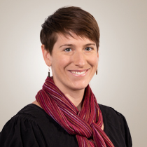
On the Role of Spatial Clustering Algorithms in Building Species Distribution Models from Community Science Data
Mark Roth¹, Dr. Tyler Hallman²,
Dr. W. Douglas Robinson³, Dr. Rebecca Hutchinson^{1,3}
1: Department of Electrical Engineering & Computer Science, Oregon State University
2: Swiss Ornithological Institute, Sempach, Switzerland
3: Department of Fisheries, Wildlife, & Conservation Sciences, Oregon State University
Notes:
Hello, thanks for joining me. [introduce topic & fact about understanding each phrase]
Throughout the presentation I'll probably alternate between using I and we and when I say we,

Slide 2
On the Role of Spatial Clustering Algorithms in Building Species Distribution Models from Community Science Data
Mark Roth¹, Dr. Tyler Hallman²,
Dr. W. Douglas Robinson³, Dr. Rebecca Hutchinson^{1,3}
1: Department of Electrical Engineering & Computer Science, Oregon State University
2: Swiss Ornithological Institute, Sempach, Switzerland
3: Department of Fisheries, Wildlife, & Conservation Sciences, Oregon State University
Notes:
these are the other individuals I am referring to. I feel lucky to be the one presenting this work, bc it would not have been possible without the help of each of these wonderful people + researchers.

Slide 3
Overview
Motivation & Background
Biodiversity Loss, Species Distribution Models, Community Science, Occupancy Models
Research area
Site Clustering Problem
Experiments, Results, Contributions
Future Work
Notes:
What each of these are and why they are important

Slide 4

Biodiversity
“Biodiversity is the foundation of [our] social and economic systems, yet we have not managed to solve the extinction crisis”
– Leah Gerber, Director of the Center for Biodiversity Outcomes at Arizona State University
https://www.nytimes.com/2021/09/30/opinion/animal-extinction.html
Notes:
Biodiversity is important to healthy ecosystems
Extinctions often cause cascading negative effects that can weaken and threaten them.
Extinction &, more generally, population decline has been a central focus of conservation science, and it remains a very difficult challenge
Help keep humans healthy (cascading effects: as vulture populations plummet, more feral dogs, more disease)

Slide 5
Biodiversity Loss
The world has seen a 68% decline in animal populations since 1970
https://www.worldwildlife.org/magazine/issues/summer-2021/
articles/a-warning-sign-where-biodiversity-loss-is-happening-around-the-world
Notes:
& the rate is actually increasing

Slide 6
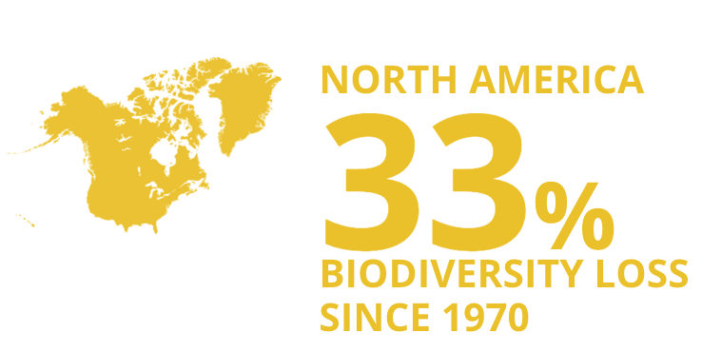
Biodiversity Loss
The world has seen a 68% decline in animal populations since 1970
https://www.worldwildlife.org/magazine/issues/summer-2021/
articles/a-warning-sign-where-biodiversity-loss-is-happening-around-the-world

Slide 7
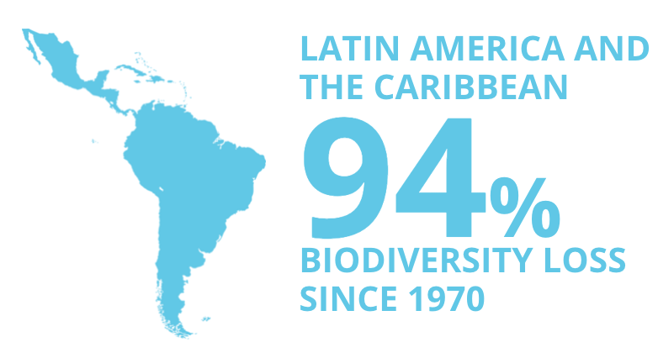
Biodiversity Loss
The world has seen a 68% decline in animal populations since 1970
https://www.worldwildlife.org/magazine/issues/summer-2021/
articles/a-warning-sign-where-biodiversity-loss-is-happening-around-the-world
Notes:
With some of this disparity is a direct result of wealthier countries exploiting the natural resources of poorer countries. In industries like logging
these declines can have cascading, irreversible effects

Slide 8
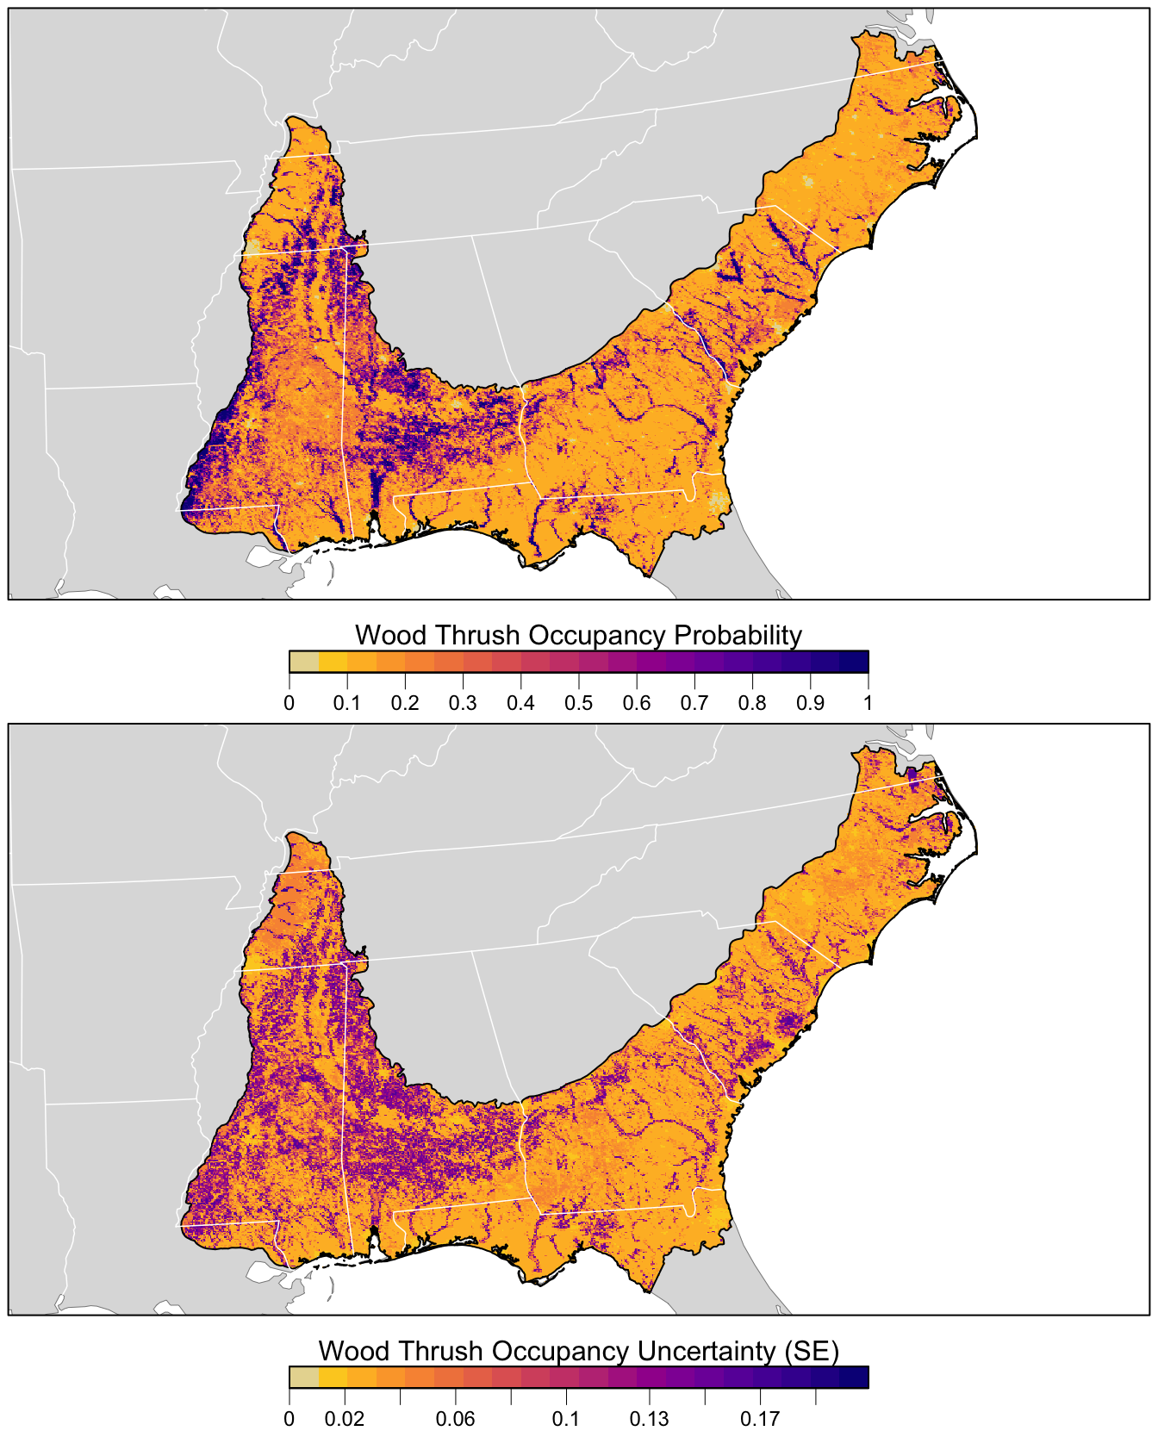
Species Distribution Models (SDMs)
Tools that predict the pattern of species activity
Integral in designing solutions to support threatened species
Johnston et al., 2021
Notes:
One of the tools conservation scientists use to help combat population decline are SDMs
They provide scientists a prediction of where species are likely to be found, even in locations where no observations were collected. Many applications, most relevant might be designing wildlife reserves or protected areas. Many SDMs are visualized as a map of occupancy probability, like so.
[
They do this by linking environmental variables to species observations to infer key characteristics of habitat requirements
]

Slide 9
Species Distribution Models (SDMs)
Tools that predict the pattern of species activity
Integral in designing solutions to support threatened species
Extent and accuracy of SDMs depend on the range and quality of the biodiversity dataset
Johnston et al., 2021
Notes:
The end product of this research is to inform and construct Species Distribution Models, or SDMs.

Slide 10
SDMs Aid Conservation Decision Making Processes
Defining wildlife reserves
Notes:
This tool helps inform conservation decisions such as defining reserves, setting hunting & fishing quotas, and dedicating necessary conservation resources for migratory species.
you might notice that much of the region in view is grayed.

Slide 11
SDMs Aid Conservation Decision Making Processes
Defining wildlife reserves
Setting hunting and fishing quotas
Notes:
This tool helps inform conservation decisions such as defining reserves, setting hunting & fishing quotas, and dedicating necessary conservation resources for migratory species.
you might notice that much of the region in view is grayed.

Slide 12
SDMs Aid Conservation Decision Making Processes
Defining wildlife reserves
Setting hunting and fishing quotas
Dedicating resources for migratory species
…
Notes:
This tool helps inform conservation decisions such as defining reserves, setting hunting & fishing quotas, and dedicating necessary conservation resources for migratory species.

Slide 13
Data required to build SDMs
Extent and accuracy of SDMs depend on the range and quality of the biodiversity dataset
Notes:
data here means observations of species
SDMs are limited by the range of observations collected.
And historically, sdms are built to understand local regions and this is bc of limited resources. it takes a lot of effort and money to collect the right data to inform these visualizations

Slide 14
Data required to build SDMs
Extent and accuracy of SDMs depend on the range and quality of the biodiversity dataset
Notes:
Larger regions
Historically, sdms are built

Slide 15
Data required to build SDMs
Extent and accuracy of SDMs depend on the range and quality of the biodiversity dataset
Presence-Background
PB
Presence-Absence
PA
Occupancy-Detection
DET
Notes:
PB – look at presences and the rest of the region
PA – look at detections & non-detections for each site
DET – PA + collect some information that allows scientists to model the detection process

Slide 16
Data required to build SDMs
Extent and accuracy of SDMs depend on the range and quality of the biodiversity dataset
Presence-Background
PB
Presence-Absence
PA
Occupancy-Detection
DET
increasing information content
Notes:
PB – look at presences and the rest of the region
PA – look at detections & non-detections for each site
DET – PA + collect some information that allows scientists to model the detection process

Slide 17
Data required to build SDMs
Extent and accuracy of SDMs depend on the range and quality of the biodiversity dataset
Presence-Background
PB
Presence-Absence
PA
Occupancy-Detection
DET
Occupancy Probability!
increasing information content
Notes:
Some intermediaries include occupancy ranking and relative likelihood
But the important thing to note is that DET is the most valuable to conservation scientists & requires some additional structure in the dataset

Slide 18
Community Science (also known as citizen science)
Voluntary crowdsourced data collection
Notes:
Community science, commonly referred to as citizen science, is a way for community members to voluntarily contribute to ongoing research initiatives. There are a lot of different avenues for individuals to make contributions, but in this research, we focus specifically on data collection.
There are a couple important characteristics of community science data;
since it is completely voluntary, observers make observations at their discretion.

Slide 19
Community Science (also known as citizen science)
Voluntary crowdsourced data collection
Low barriers to contribute
Notes:
they also celebrate a wide range of observer experience; no obstacles to contribute

Slide 20
Community Science (also known as citizen science)
Voluntary crowdsourced data collection
Low barriers to contribute
Growing in volume and quality
Notes:
CSD surpass data collection ranges of any single study

Slide 21
Community Science (also known as citizen science)
Voluntary crowdsourced data collection
Low barriers to contribute
Growing in volume and quality
We can construct spatially and temporally comprehensive SDMs !
Notes:
At the same time, CSD also introduces a handful of biases and challenges. The challenge most relevant to our research is the concept of imperfect detection.

Slide 22
Imperfect Detection
Probability of detecting a species given that it is present is less than 1
Notes:
ID is the assumption that the probability of detecting a species given that it is present is less than 1
we know that some species can be hard to detect: they can hide, many have camouflage, or the observer might just miss them. This phenomenon affects expert observers but community scientists with less training are even more impacted.

Slide 23
Imperfect Detection
Probability of detecting a species given that it is present is less than 1
Ignoring imperfect detection can lead to biased estimates of occupancy (Guillera-Arroita et al., 2014)
Notes:
And, unsurprisingly, Ignoring imperfect detection can lead to biased estimates of occupancy [eBird data]

Slide 24
Imperfect Detection
Probability of detecting a species given that it is present is less than 1
Ignoring imperfect detection can lead to biased estimates of occupancy (Guillera-Arroita et al., 2014)
Occupancy Models!
Notes:
So, it is important to use a methodology to account for imperfect detection and the dominant approach in statistical ecology is occupancy modeling

Slide 25
Occupancy Models
Rely on a few key assumptions to account for imperfect detection:
Notes:
To correct for imperfect detection, OMs rely on a few assumptions and a rigid observational structure.

Slide 26
Occupancy Models
Rely on a few key assumptions to account for imperfect detection:
No false positives
Notes:
First, no false positives... there are many examples

Slide 27
Occupancy Models
Rely on a few key assumptions to account for imperfect detection:
No false positives
N observations are organized into a set of <N sites
Notes:
it expects the N observations to be organized into <= N sites; so each site has at least 1 visit.

Slide 28
Occupancy Models
Rely on a few key assumptions to account for imperfect detection:
No false positives
N observations are organized into a set of <N sites
At each site, we assume closure: the occupancy status remains unchanging across all observations
Notes:
This model also assumes closure at each site, meaning the occupancy status remains unchanging across multiple visits and we will show why that is important.

Slide 29



Occupancy Model – Intuition
Notes:
We can demonstrate the intuition with this example. Consider the outlined region a single site. We visit once, no detection, twice no detection, and on the third visit, we see our species. Then, we can conclude, in this simple example, that our detection probability is 1/3.
This is just the intuition, in the statistical model, many sites and repeated observations are aggregated and the probabilities are linked to covariates

Slide 30
Occupancy Model – Intuition
Observations: [0, 0, 1]
Notes:
We can demonstrate the intuition with this example. Consider the outlined region a single site. We visit once, no detection, twice no detection, and on the third visit, we see our species. Then, we can conclude, in this simple example, that our detection probability is 1/3.
This is just the intuition, in the statistical model, many sites and repeated observations are aggregated and the probabilities are linked to covariates

Slide 31
Occupancy Model – Intuition
Observations: [0, 0, 1]
Detection probability = 1/3
Notes:
We can demonstrate the intuition with this example. Consider the outlined region a single site. We visit once, no detection, twice no detection, and on the third visit, we see our species. Then, we can conclude, in this simple example, that our detection probability is 1/3.

Slide 32
Occupancy Model – Intuition
Notes:
One reason this helps is when consider other sites. Let’s say we can only visit another site once and we do not detect the species. With perfect detection, we would have to assume the site is unoccupied. But knowing that our detection probability is 1/3, there’s still a good chance that the bird is present, and we just missed it.
This is just the intuition, in the statistical model, many sites and repeated observations are aggregated

Slide 33
Imperfect Detection, constant p
Site 1: p₁ = 1/3
Site 1: p₂ = 1/3
Notes:
In this case, we are assuming p to be constant, like so:

Slide 34
Imperfect Detection, p is a function of detection variables
Site 2:
p₂ = x * 1/# trees
Site 1:
p₁ = 1/3 * 1/# trees
Notes:
But p can also be a function of the detection variables; for simplicity's sake, we can say the fewer trees means detection probability is higher

Slide 35
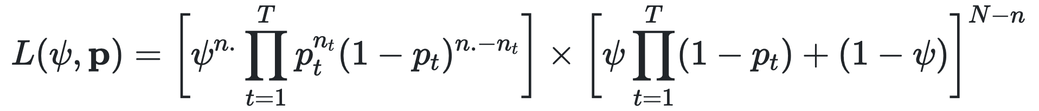
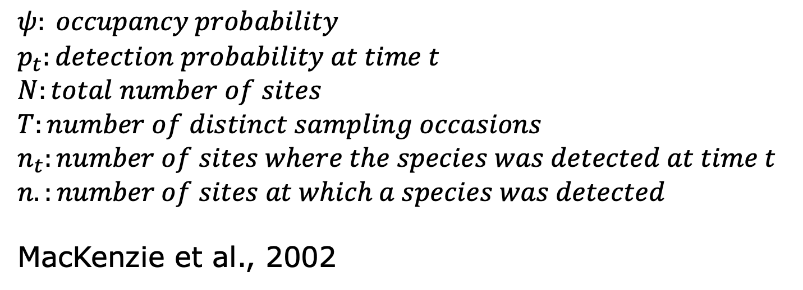
Occupancy Model MLE for a single site
$$ψ: occupancy probability$$
$$p_{t}:detection probability at time t$$
$$N:total number of sites$$
$$T:number of distinct sampling occasions$$
$$n_{t}:number of sites where the species was detected at time t$$
$$n.:number of sites at which a species was detected$$
MacKenzie et al., 2002
Notes:
These groupings of observations are fed into a MLE equation which produces a relationship between the environmental variables and the occupancy probability. i dont time to go too in-depth on this model, but the citation is there if you are curious.
L(\Theta) = \prod_{i=1}^M \bigg[ \psi_i \prod_{t=1}^T [\ p_{it}^{Y_{it}}(1-p_{it})^{1-Y_{it}}] + (1 - \psi_{i}) I \bigg( ( \sum_{t=1}^T Y_{it}) = 0 \bigg) \bigg]

Slide 36
Occupancy Model Output
Provides equations for occupancy & detection probabilities
Notes:
A prediction

Slide 37
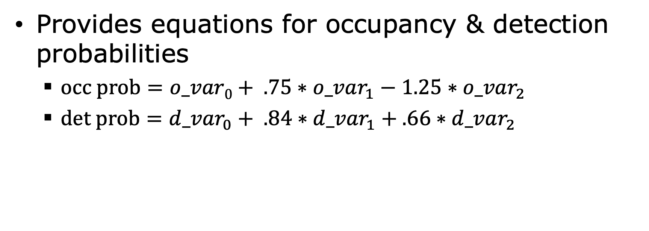
Occupancy Model Output
Provides equations for occupancy & detection probabilities
$occ prob=o_var0+ .75∗o_var_{1}−1.25∗o_var_{2}$
$det prob={d_var}_{0}+ .84∗{d_var}_{1}+.66∗d_var_{2}$
Notes:
With this, we can calculate the probability of occupancy across all regions where we have these variables

Slide 38
Occupancy Models
Rely on a few key assumptions to account for imperfect detection:
No false positives
N observations are organized into a set of <N sites
At each site, we assume closure: the occupancy status remains unchanging across all observations
Scientists design sites prior to sampling to ensure closure, but this is not the case with community science!
Notes:
Alright, so we have an idea of why occupancy models are helpful in correcting imperfect detection and how they work. If we return briefly to our assumptions…

Slide 39

Pathway to mitigate biodiversity loss
Unstructured, crowdsourced biodiversity datasets; imperfect detection
Notes:
Now I wanted to take a brief step back to contextualize our research goal before we jump into the ML aspect of this project
We begin with data collection, which is our crowdsourced community dataset.

Slide 40
Pathway to mitigate biodiversity loss
OMs
Unstructured, crowdsourced biodiversity datasets; imperfect detection
Notes:
and to correct for imperfect detection, we feed this data into an OM, which then allows us to create a SDM map.

Slide 41
Pathway to mitigate biodiversity loss
OMs
Unstructured, crowdsourced biodiversity datasets; imperfect detection

Slide 42

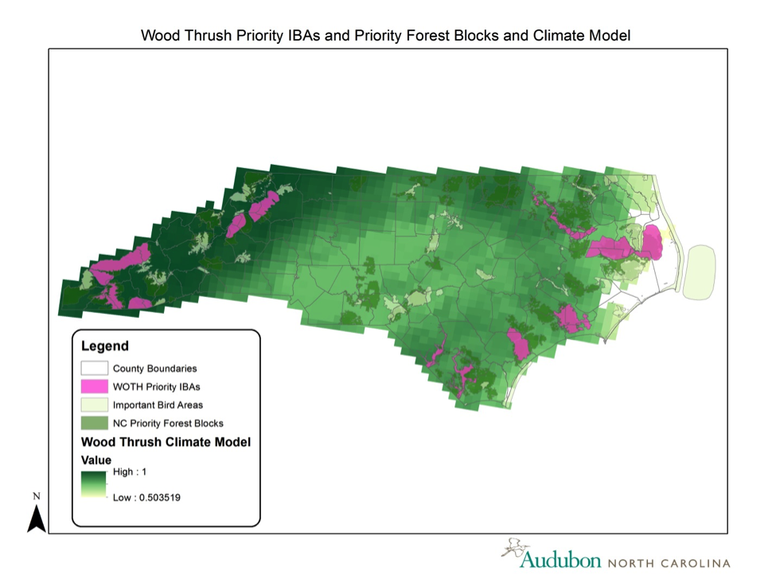
Pathway to mitigate biodiversity loss
Group observations into sites while maintaining closure
OMs
Unstructured, crowdsourced biodiversity datasets; imperfect detection
Natural Resource Management
Notes:
This model can provide valuable insight into species dynamics and allow scientists to identify regions of interest and importance.
So where does our research fit in? Well, recall that one of the benefits of community science data collection is that there are low barriers to contribute and this leads to unstructured data. however, OMs rely on a rigid observational structure focused on the definition of a site. Our research introduces a step between data collection and species modeling where we group observations into sites to increase the potential impact of SDMs built from community science data.

Slide 43
Group observations into sites while maintaining closure

Slide 44
Site Clustering Problem
Group observations into sites while maintaining closure

Slide 45
Site Clustering Problem
{
Discover the optimal number of sites automatically
Group observations into sites while maintaining closure

Slide 46
Site Clustering Problem
{
Discover the optimal number of sites automatically
Respect geospatial & temporal constraints imposed by species behavior
Group observations into sites while maintaining closure

Slide 47
Site Clustering Problem
{
Discover the optimal number of sites automatically
Respect geospatial & temporal constraints imposed by species behavior
Consider similarity in geospatial & feature space
Group observations into sites while maintaining closure

Slide 48
Site Clustering Problem
{
Discover the optimal number of sites automatically
Respect geospatial & temporal constraints imposed by species behavior
Consider similarity in geospatial & feature space
Run efficiently on large datasets
Group observations into sites while maintaining closure

Slide 49


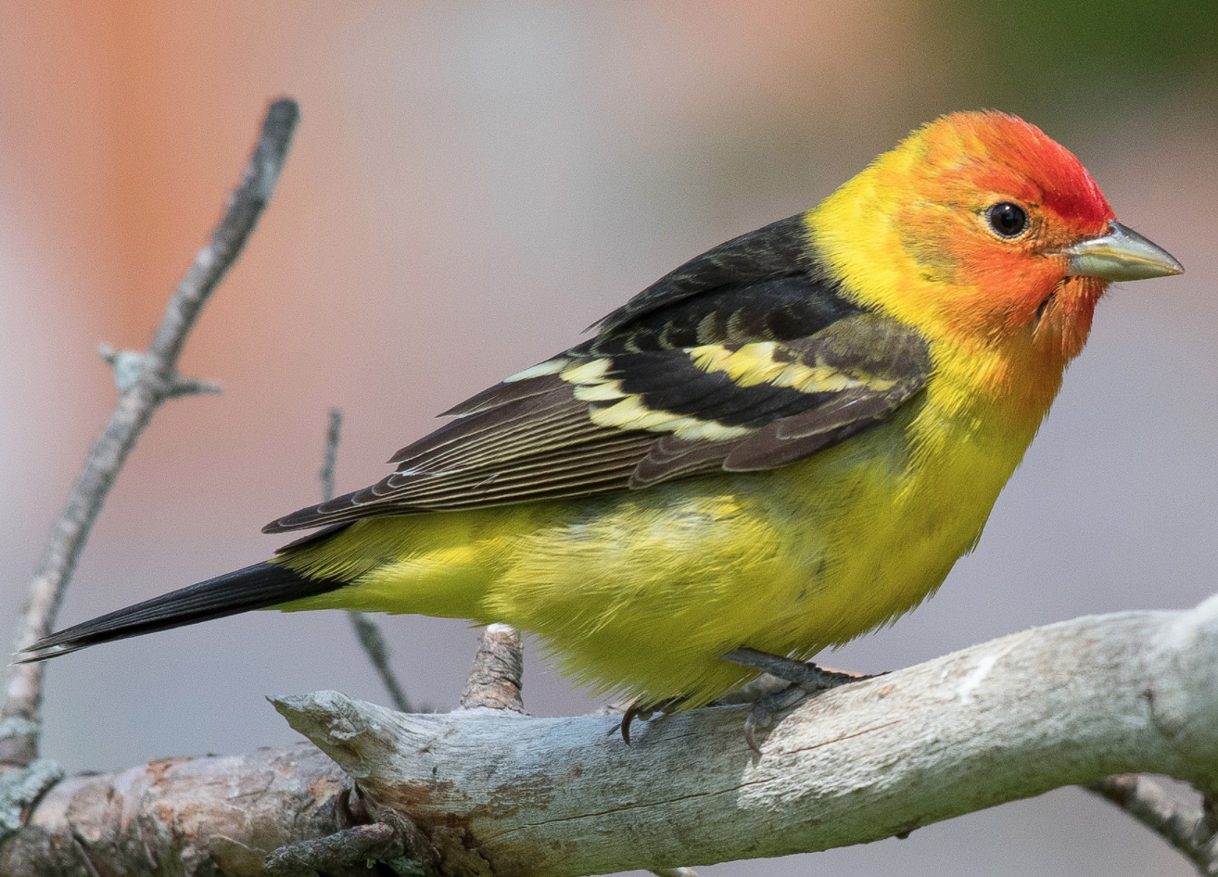
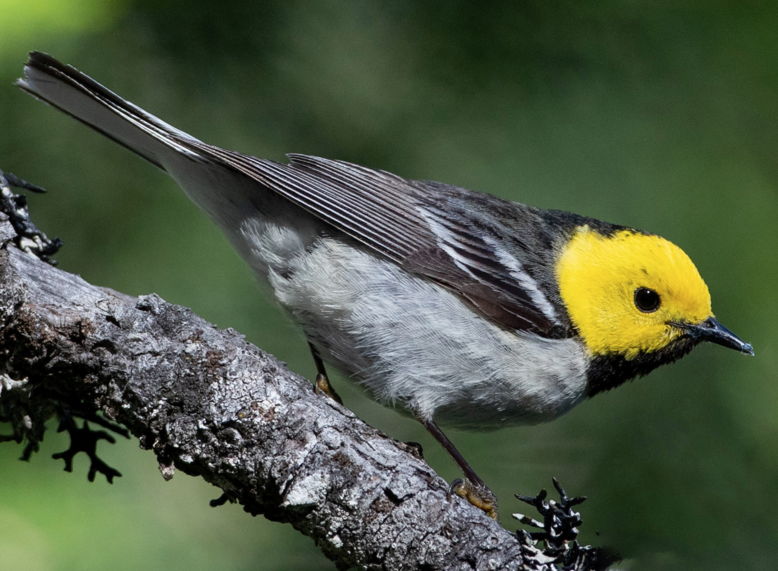
Western Tanager (WETA), eBird.org
Hermit Warbler (HEWA), eBird.org
Notes:
This research focuses on eBird; a community science program created and maintained by the Cornell Lab of Ornithology. & here are two species that we will talk a bit more about later in the presentation

Slide 50
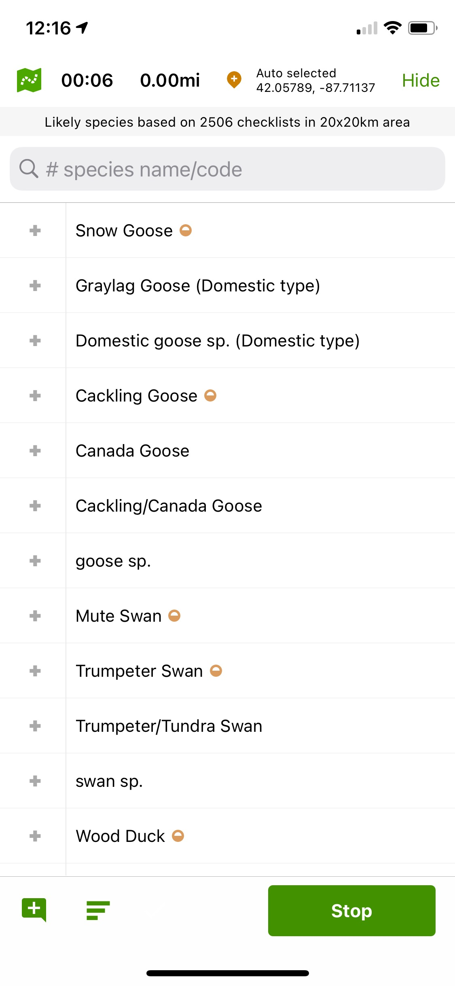
The eBird Community Science Program
Created in 2002
Mobile application to record birding observations (checklists)
>1 billion checklists submitted

Slide 51
Existing Methods

Slide 52
Existing Methods
eBird Best Practices
Same observer, same latitude-longitude coordinate, > 1 visit and at most 10 visits

Slide 53
Existing Methods
eBird Best Practices
Same observer, same latitude-longitude coordinate, > 1 visit and at most 10 visits
Grid
Most commonly, 1x1km
Retains less than 25% of available data!
Notes:
we had our doubts about both of these; throws away >75% of data in our case study

Slide 54
Can we improve upon the existing methods by framing the Site Clustering Problem as a spatial clustering problem?
Notes:
The objective of these sp cl algorithms is to group eBird checklists into sites that maintain closure.

Slide 55
Existing Spatial Clustering Algorithms
Notes:
Partitioning methods such as k-means and CLARANS require a user-defined number of clusters
Density-based methods such as DBSCAN, and regionalization methods, such as SKATER and REDCAP are guided by the density of points, but closure is independent of density

Slide 56
Existing Spatial Clustering Algorithms
k-means (Llyod, 1982)
CLARANS (Ng & Han, 2002)
Partitioning
Notes:
Partitioning methods such as k-means and CLARANS require a user-defined number of clusters
Density-based methods such as DBSCAN, and regionalization methods, such as SKATER and REDCAP are guided by the density of points, but closure is independent of density

Slide 57
Existing Spatial Clustering Algorithms
k-means (Llyod, 1982)
CLARANS (Ng & Han, 2002)
DBSCAN (Ester et al., 1996)
DBRS (Wang & Hamilton, 2003)
SKATER (Assunção et al., 2006)
REDCAP (Guo, 2008)
For a more complete review see Liu et al. 2012
Partitioning
Density Based
Regionalization
Notes:
Partitioning methods such as k-means and CLARANS require a user-defined number of clusters
Density-based methods such as DBSCAN, and regionalization methods, such as SKATER and REDCAP are guided by the density of points, but closure is independent of density

Slide 58
Algorithms in this report
lat-long
rounded-4
Notes:
In our paper we expand on the ways existing algorithms are not well suited for this problem – and Liu et al

Slide 59
Algorithms in this report
lat-long
rounded-4
Density-based spatially-constrained (DBSC) (Liu et al., 2012)
Notes:
In our paper we expand on the ways existing algorithms are not well suited for this problem – and Liu et al

Slide 60
Algorithms in this report
lat-long
rounded-4
Density-based spatially-constrained (DBSC) (Liu et al., 2012)
clustGeo (Chavent et al., 2018)
Notes:
In our paper we expand on the ways existing algorithms are not well suited for this problem – and Liu et al

Slide 61
DBSC: An Overview
Constructing spatial proximity relationships
Notes:
2 step process DT: kind of like saying there are edges to each points nearest neighbors in all directions

Slide 62
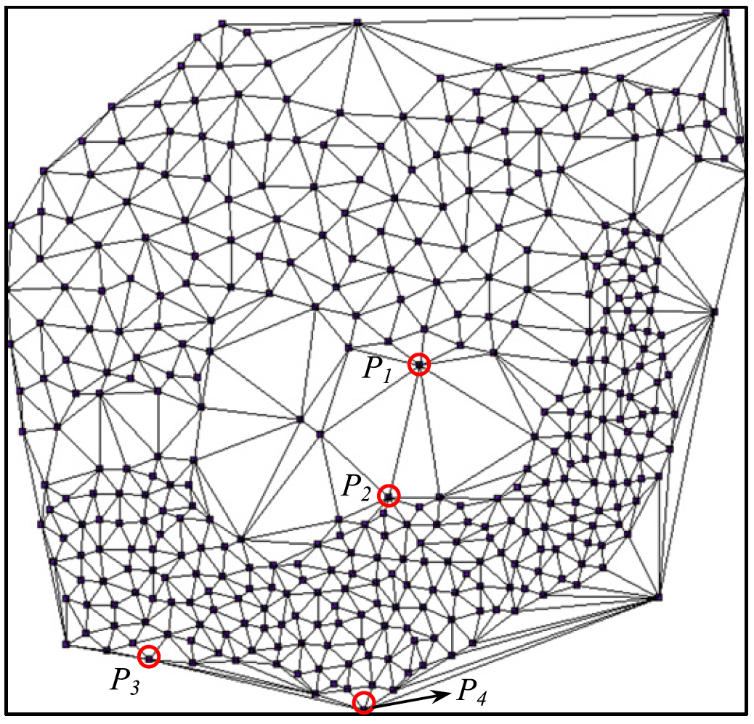
DBSC: An Overview
Constructing spatial proximity relationships
Delanauy Triangulation
Notes:
2 step process Dee-loan-ay
DT: kind of like saying there are edges to each points nearest neighbors in all directions

Slide 63
DBSC: An Overview
Constructing spatial proximity relationships
Delanauy Triangulation
Remove global & local long edges
Notes:
2 step process DT: kind of like saying there are edges to each points nearest neighbors in all directions

Slide 64
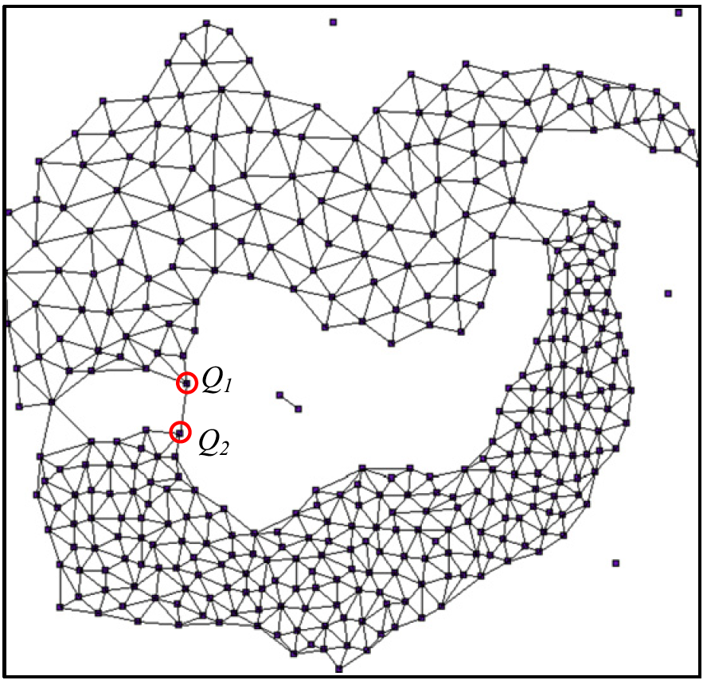
DBSC: An Overview
Constructing spatial proximity relationships
Delanauy Triangulation
Remove global & local long edges
Notes:
2 step process DT: kind of like saying there are edges to each points nearest neighbors in all directions

Slide 65
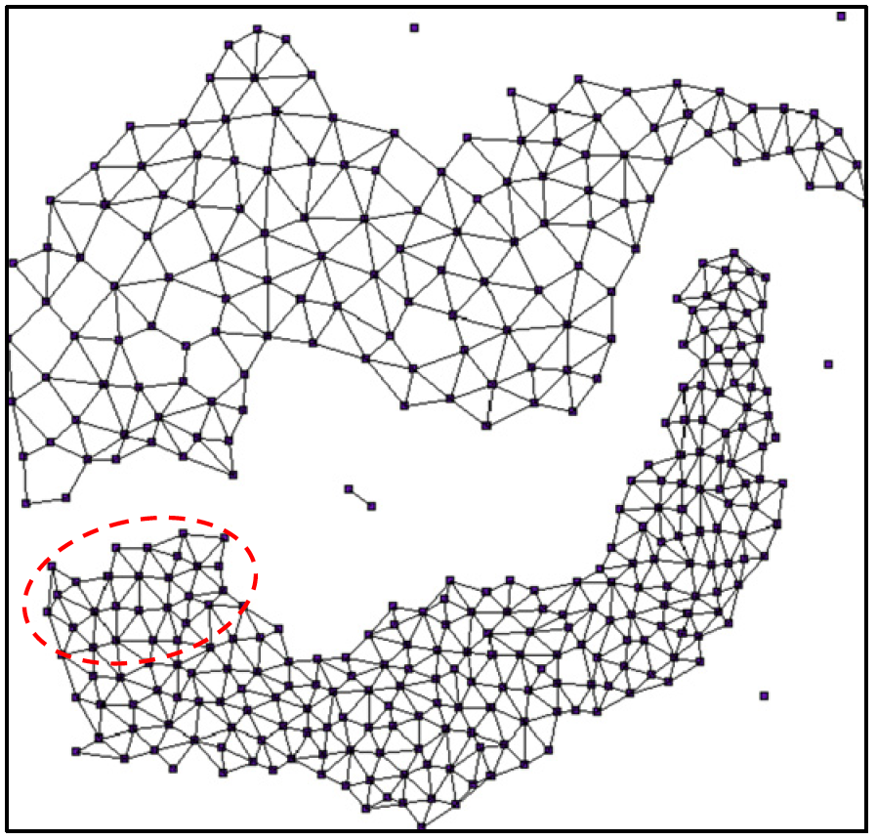
DBSC: An Overview
Constructing spatial proximity relationships
Delanauy Triangulation
Remove global & local long edges
Notes:
2 step process DT: kind of like saying there are edges to each points nearest neighbors in all directions

Slide 66
DBSC: An Overview
Constructing spatial proximity relationships
Delanauy Triangulation
Remove global & local long edges
Grouping similar data points
Notes:
2 step process DT: kind of like saying there are edges to each points nearest neighbors in all directions

Slide 67
DBSC: An Overview
Constructing spatial proximity relationships
Delanauy Triangulation
Remove global & local long edges
Grouping similar data points
Must be neighbors
Notes:
2 step process DT: kind of like saying there are edges to each points nearest neighbors in all directions

Slide 68
DBSC: An Overview
Constructing spatial proximity relationships
Delanauy Triangulation
Remove global & local long edges
Grouping similar data points
Must be neighbors
Distance in feature space must be below a certain threshold
Notes:
2 step process DT: kind of like saying there are edges to each points nearest neighbors in all directions

Slide 69
clustGeo: An Overview
d(x,y) = α d₁(x,y) + (1- α) d₂(x,y)
Notes:
Weighted average of 2 different distance functions with a mixing parameter alpha. and alpha determines the emphasis to place on spatial similarity vs feature similarity

Slide 70
clustGeo: An Overview
d(x,y) = α d₁(x,y) + (1- α) d₂(x,y)
spatial distance
environmental
distance
Notes:
Weighted average where alpha determines the emphasis to place on spatial similarity vs feature similarity

Slide 71
clustGeo: An Overview
d(x,y) = α d₁(x,y) + (1- α) d₂(x,y)
Continuously cluster the most similar objects together
spatial distance
environmental
distance
Notes:
You might be wondering, ‘well when does it stop?’, and its stops when all objects belong in a single cluster; this is what’s known as an agglomerative hierarchical clustering algorithm

Slide 72
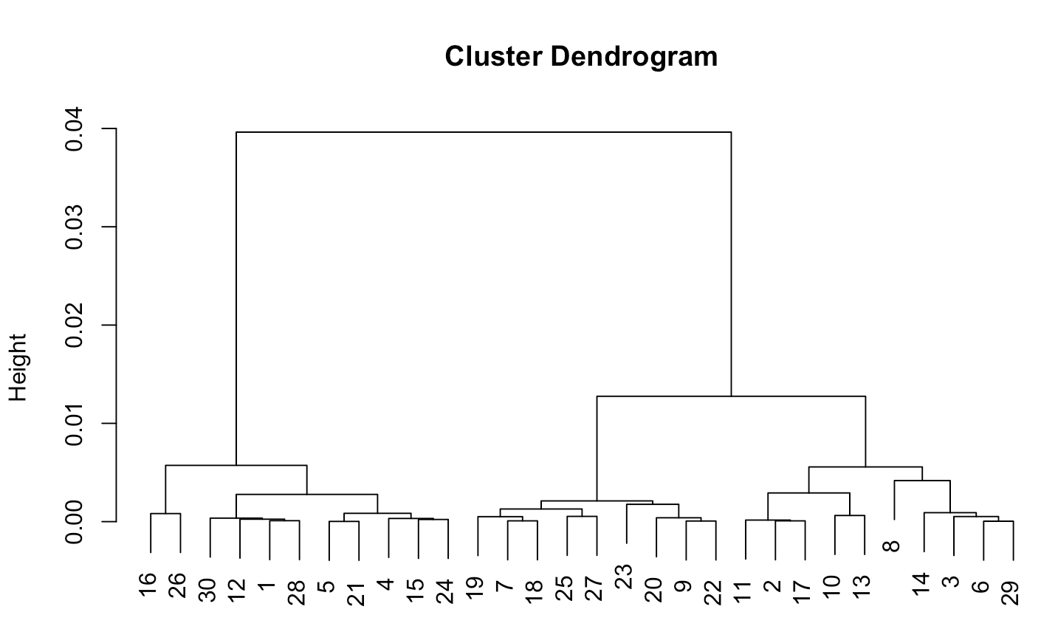
clustGeo: An Overview
Distance
Data Points
Notes:
The final step is to decide how many clusters you’d like, and this is tricky for us because we don’t know how many sites there should be.

Slide 73
clustGeo: An Overview
Distance
Fewer Sites
More Sites
Data Points

Slide 74
clustGeo: An Overview
α = .8
# of sites ≈ # of unique locations * .85
Notes:
The final step is to decide how many clusters you’d like

Slide 75
Algorithms in this report
lat-long
rounded-4
Density-based spatially-constrained (DBSC) (Liu et al., 2012)
clustGeo (Chavent et al., 2018)
Consensus Clustering
Agglomerative & Balls Implementations (Gionis et al., 2007)
Notes:
In our paper we expand on the ways existing algorithms are not well suited for this problem – and Liu et al

Slide 76
Experimental Setup
Real Data
Semi-Simulated
Simulated
Adversarial
Notes:
Simulated species; gives us access to ground truth & underlying generative model; many names: virtual, synthetic simulated, all mean the same thing

Slide 77
Experimental Setup
Real Data
Semi-Simulated
Simulated
Adversarial
Simulated Species
Notes:
Simulated species; gives us access to ground truth & underlying generative model; as we discussed before, the output of an OM is an equation for occupancy probability. and in these experiments, we actually define this equation and see how similar it is to our predicted model; many names: virtual, synthetic simulated, all mean the same thing

Slide 78
Experimental Setup
Real Data
Semi-Simulated
Simulated
Adversarial
Simulated Species
Notes:
Simulated species; gives us access to ground truth & underlying generative model; many names: virtual, synthetic simulated, all mean the same thing

Slide 79
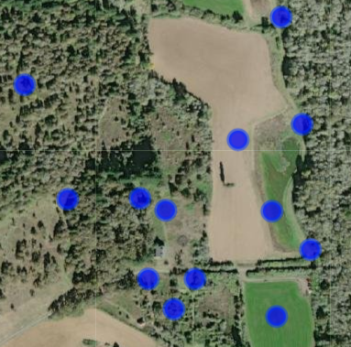
Modeling Process
Notes:
Before talking about whats different in each of these experiments I wanted to talk about the modeling process, which stays the same throughout each of them.

Slide 80
Modeling Process
Clustering
Notes:
This is the crux of our research, bc it’s the place where each algorithm differs

Slide 81
Modeling Process
Clustering
OM

Slide 82
Modeling Process
Clustering
OM
occ_prob = β₀ + β₁ * occ_var₁ + …
det_prob = α₀ + α₁ * det_var₁ + …

Slide 83
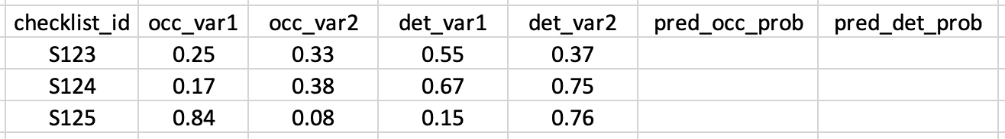
Modeling Process
Clustering
OM
occ_prob = β₀ + β₁ * occ_var₁ + …
det_prob = α₀ + α₁ * det_var₁ + …

Slide 84
Modeling Process
Clustering
OM
occ_prob = β₀ + β₁ * occ_var₁ + …
det_prob = α₀ + α₁ * det_var₁ + …

Slide 85
Experiments!

Slide 86
Real Data Experiment
>2,000 checklists from eBird
collected between May and July 2017
Occ/Det Variables
Detections/Non-detections for WETA & HEWA
Notes:
Group these checklists into sites with our various clustering algorithms & check performance
True values of our latent variables, which let us test how well our clustering algorithms performed.

Slide 87
Real Data Experiment
>2,000 checklists from eBird
collected between May and July 2017
Occ/Det Variables
Detections/Non-detections for WETA & HEWA
occ_prob = 1.24 + .86 * occ_var₁ + …
det_prob = .99 - .31 * det_var₁ + …
Notes:
Group these checklists into sites with our various clustering algorithms & check performance; feed into OM → equations. However we can’t directly measure how similar this equation is to the underlying generative model, because that doesn’t exist for real date.

Slide 88
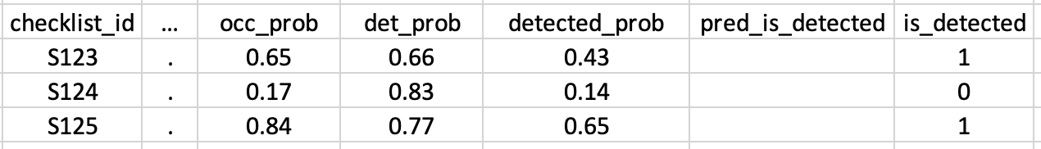
Real Data Evaluation: ROC/AUC
Notes:
Instead, we take these predicted occ/det probabilities and multiply them to get a detected probability, and we will compare this with the data that we have: detections… but this introduces a natural question

Slide 89
Real Data Evaluation: ROC/AUC
Discrimination Threshold: what constitutes a predicted detection?

Slide 90
Real Data Evaluation: ROC/AUC
Discrimination Threshold = .5
Notes:
Intuition might say .5…

Slide 91
Real Data Evaluation: ROC/AUC
0
0
1
Discrimination Threshold = .5
Notes:
ROC
If interested to learn more about ROC, I would refer you to my lab mate, Nahian who is studying them in more depth

Slide 92
Real Data Evaluation: ROC/AUC
0
0
1
Discrimination Threshold = .5
TPR := TP/P = 1/2
FPR := FP/N = 0/1
Notes:
ROC
If interested to learn more about ROC, I would refer you to my lab mate, Nahian who is studying them in more depth

Slide 93
Real Data Evaluation: ROC/AUC
0
0
1
Discrimination Threshold = .5
TPR := TP/P = 1/2
FPR := FP/N = 0/1
Notes:
ROC
If interested to learn more about ROC, I would refer you to my lab mate, Nahian who is studying them in more depth

Slide 94
Real Data Evaluation: ROC/AUC
0
0
1
Discrimination Threshold = .5
TPR := TP/P = 1/2
FPR := FP/N = 0/1
Notes:
ROC
If interested to learn more about ROC, I would refer you to my lab mate, Nahian who is studying them in more depth

Slide 95
Real Data Evaluation: ROC/AUC
?
?
?
What about other discrimination thresholds?
Notes:
ROC
If interested to learn more about ROC, I would refer you to my lab mate, Nahian who is studying them in more depth

Slide 96

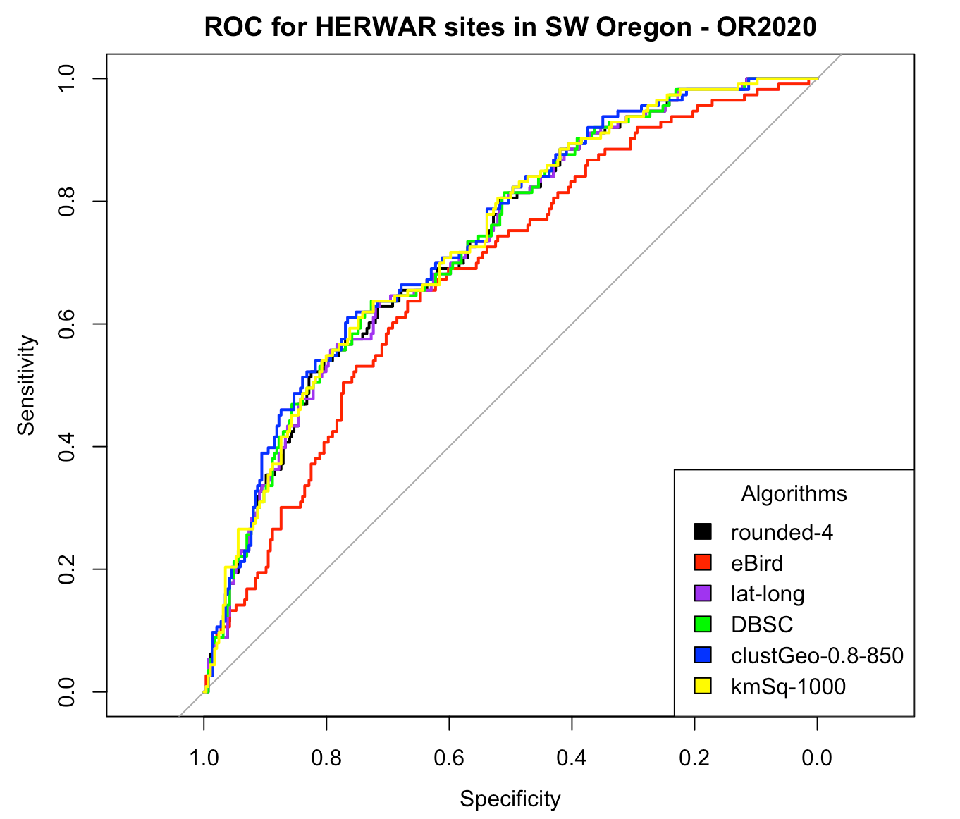
ROC Example
Notes:
X-axis: FPR
Y-axis: TPR
& data point represents the TPR&FPR at a particular threshold
here, the ideal model occurs at the top left of our graph.
its common to pick the discrimination threshold that gives you the best performance, but its also interesting to think about how your model performance varies with discrimination threshold/. to this end, there's a metric AUC

Slide 97
AUC (Area under the Curve): higher is better
Notes:
X-axis: FPR
Y-axis: TPR
& data point represents the TPR&FPR at a particular threshold

Slide 98
Real Data Evaluation: Training vs Validation
?
?
?
Notes:
ROC
If interested to learn more about ROC, I would refer you to my lab mate, Nahian who is studying them in more depth

Slide 99
Real Data Evaluation: Training vs Validation
?
?
?
OR2020: Silver Standard
Notes:
A statewide benchmark of Oregon’s birds

Slide 100
Real Data Evaluation: Training vs Validation
?
?
?
OR2020: Silver Standard
Random Selection

Slide 101
Simulated Experiments!
Notes:
occ/det covs which the occ model requires

Slide 102
Simulated Species Creation
Select locations and attach occupancy and detection variables
Notes:
occ/det covs which the occ model requires

Slide 103
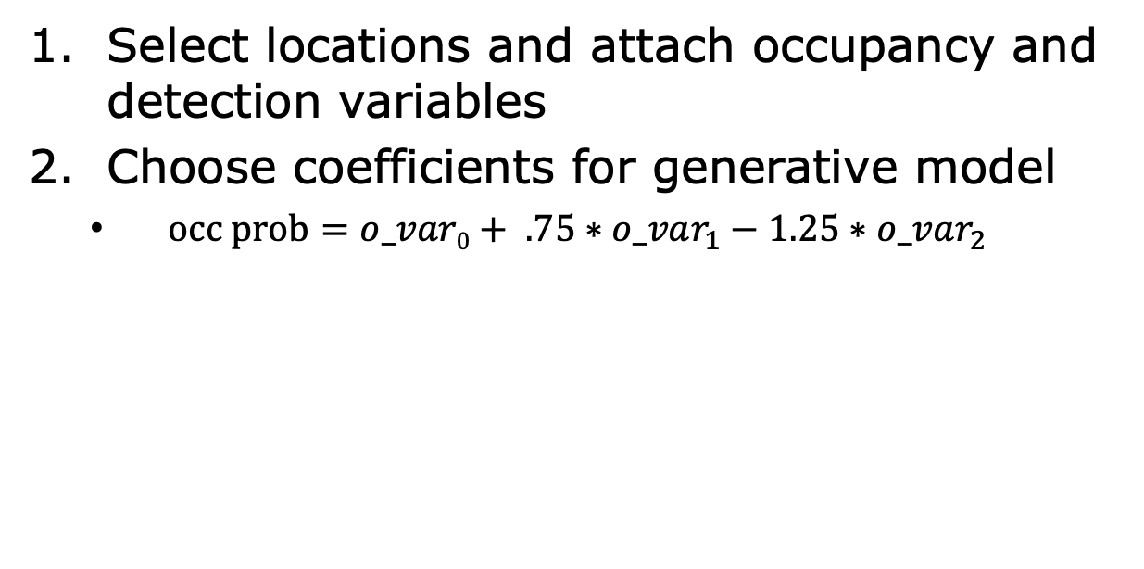
Simulated Species Creation
Select locations and attach occupancy and detection variables
Choose coefficients for generative model
$occ prob=o_var0+ .75∗o_var_{1}−1.25∗o_var_{2}$
Notes:
Group these checklists into sites with our various clustering algorithms
True values of our latent variables, which let us test how well our clustering algorithms performed.

Slide 104
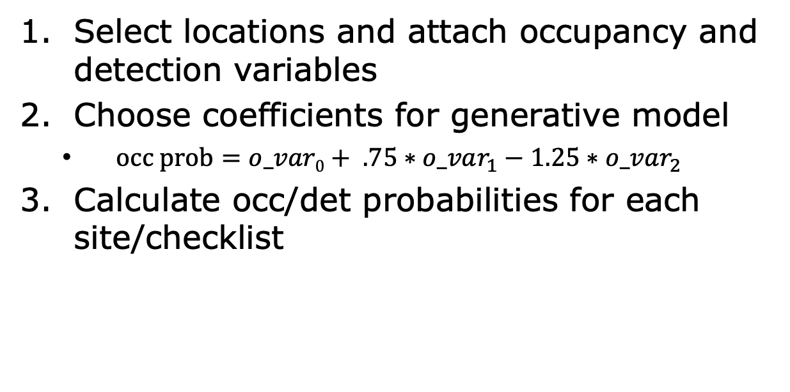
Simulated Species Creation
Select locations and attach occupancy and detection variables
Choose coefficients for generative model
$occ prob=o_var0+ .75∗o_var_{1}−1.25∗o_var_{2}$
Calculate occ/det probabilities for each site/checklist
Notes:
Group these checklists into sites with our various clustering algorithms
True values of our latent variables, which let us test how well our clustering algorithms performed.

Slide 105
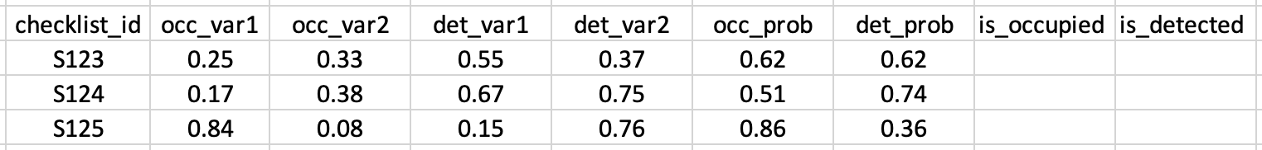
Simulated Species Creation
Select locations and attach occupancy and detection variables
Choose coefficients for generative model
$occ prob=o_var0+ .75∗o_var_{1}−1.25∗o_var_{2}$
Calculate occ/det probabilities for each site/checklist
Notes:
Goal:
True values of our latent variables, which let us test how well our clustering algorithms performed.

Slide 106
Simulated Species Creation
Select locations and attach occupancy and detection variables
Choose coefficients for generative model
$occ prob=o_var0+ .75∗o_var_{1}−1.25∗o_var_{2}$
Calculate occ/det probabilities for each site/checklist
1
0
0
0
Notes:
Right now we only have probabilities, but what we want is actual detections; so we flip a coin with probability of landing 1 equal to our occupancy probability: in this case we get 1. we can do the same for detections, and note that in this scenario, our species was occupied but not detected which is an instance of imperfect detection.
Also, if we flip our occupancy coin and it turns out the species is not occupied, we can say the species was not detected without having to flip a coin (no false positives)
So whenever we are talking about a semi- or fully simulated species, this is how we are creating it.

Slide 107
On to the experiments…
Notes:
Right now we only have probabilities, but what we want is actual detections; so we flip a coin with probability of landing 1 equal to our occupancy probability: in this case we get 1. we can do the same for detections, and note that in this scenario, our species was occupied but not detected which is an instance of imperfect detection.
Also, if we flip our occupancy coin and it turns out the species is not occupied, we can say the species was not detected without having to flip a coin (no false positives)
So whenever we are talking about a semi- or fully simulated species, this is how we are creating it.

Slide 108
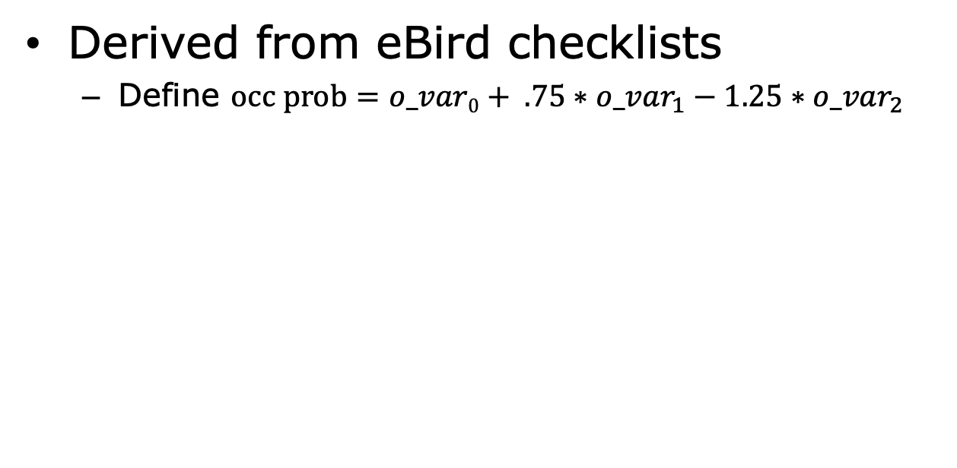
Semi-Simulated Experiments
Derived from eBird checklists
Define $occ prob=o_var0+ .75∗o_var_{1}−1.25∗o_var_{2}$
Notes:
Group these checklists into sites with our various clustering algorithms
True values of our latent variables, which let us test how well our clustering algorithms performed.

Slide 109
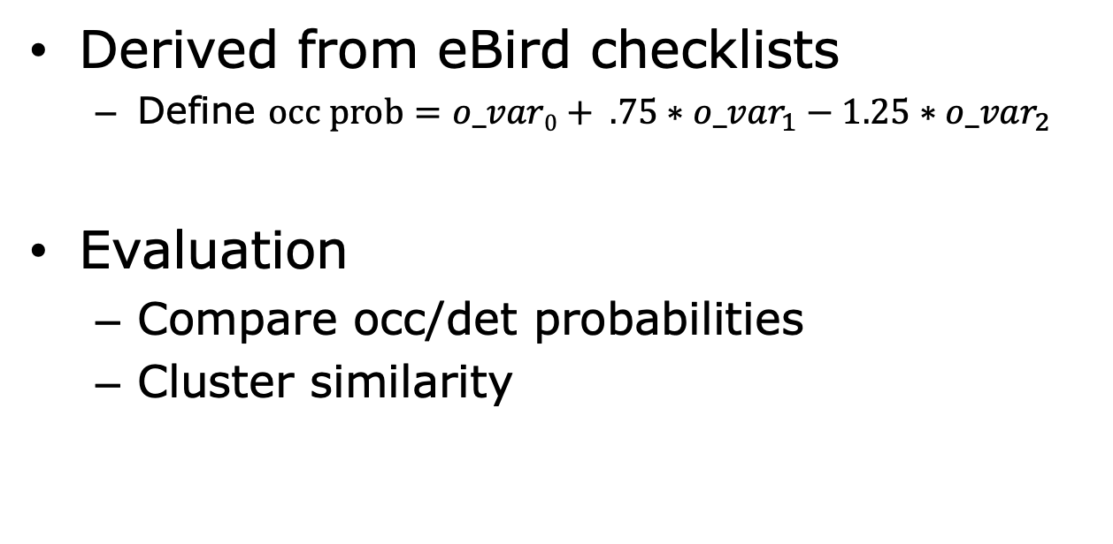
Semi-Simulated Experiments
Derived from eBird checklists
Define $occ prob=o_var0+ .75∗o_var_{1}−1.25∗o_var_{2}$
Evaluation
Compare occ/det probabilities
Cluster similarity

Slide 110
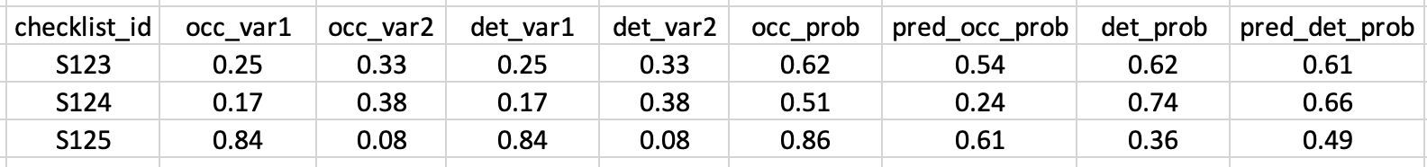
Semi-Simulated Experiments
Derived from eBird checklists
Define $occ prob=o_var0+ .75∗o_var_{1}−1.25∗o_var_{2}$
Evaluation
Compare occ/det probabilities
Cluster similarity

Slide 111
Semi-Simulated Experiments
Derived from eBird checklists
Define $occ prob=o_var0+ .75∗o_var_{1}−1.25∗o_var_{2}$
Evaluation
Compare occ/det probabilities
Cluster similarity
Mean Squared Error (MSE)

Slide 112
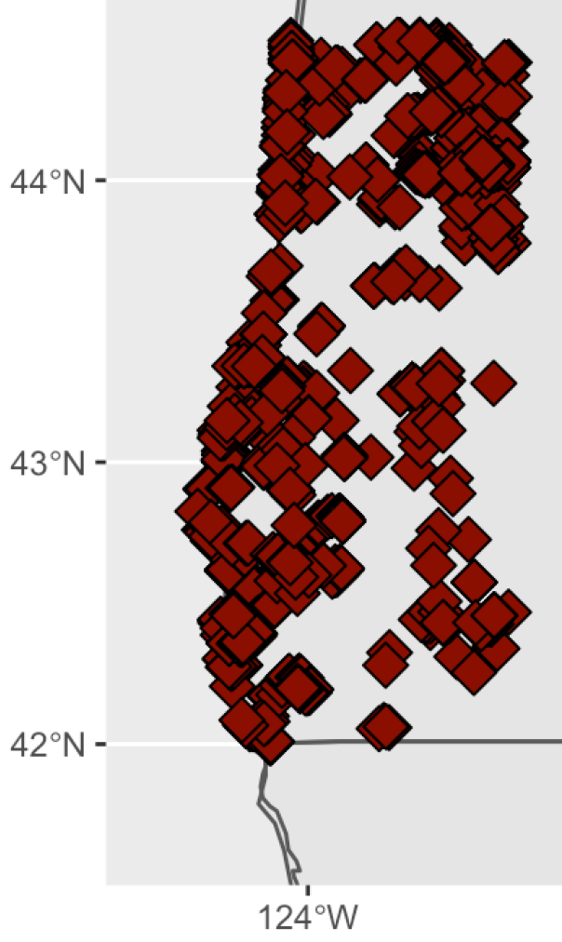
Cluster Similarity
Constructed a ground truth clustering
Notes:
we were able to measure cluster similarity because we manually created a ground truth grouping of checklists into sites. went checklist by checklist to see if an expert would consider these the same site
Doug + Tyler
True values of our latent variables, which let us test how well our clustering algorithms performed.

Slide 113
Cluster Similarity
Constructed a ground truth clustering
Cluster similarity
Adjusted Rand Index (ARI)
Adjusted Mutual Index (AMI)
Normalized Information Distance
(NID) (Vinh et al., 2010)
Ground Truth Clustering
Clustering 1
Notes:
Doug + Tyler
True values of our latent variables, which let us test how well our clustering algorithms performed.

Slide 114
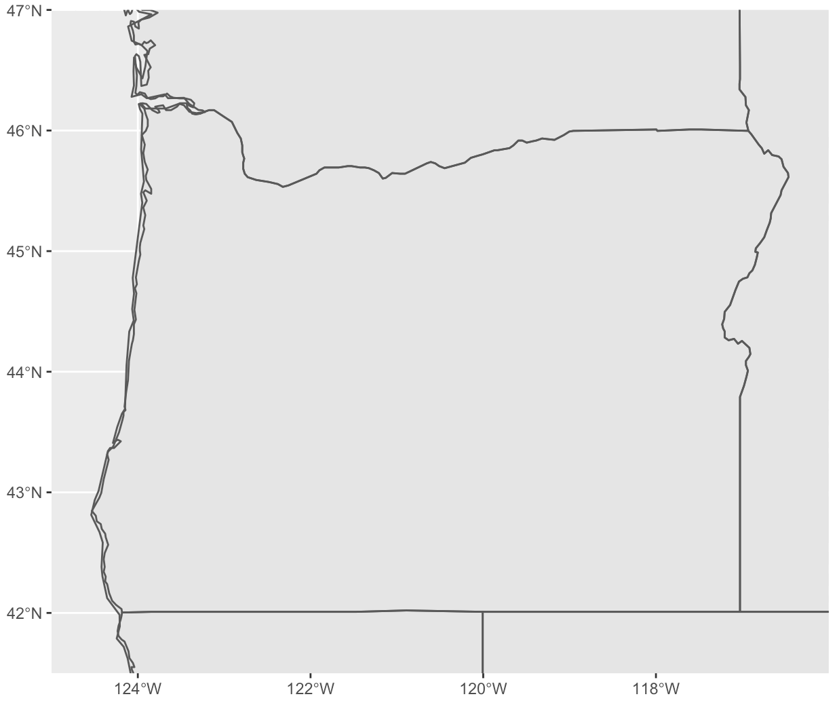
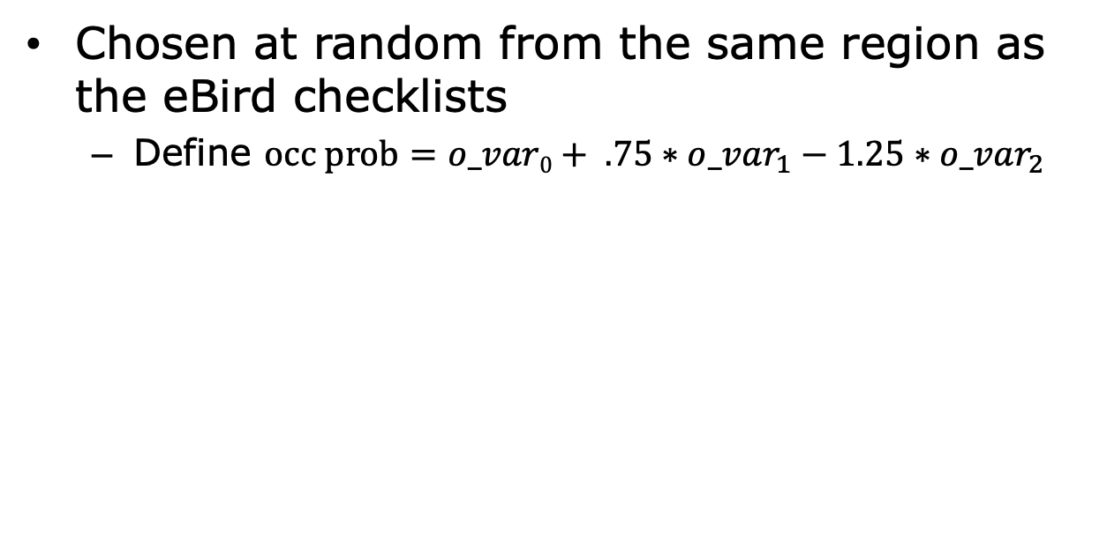
Simulated Experiments
Chosen at random from the same region as the eBird checklists
Define $occ prob=o_var0+ .75∗o_var_{1}−1.25∗o_var_{2}$
Notes:
Group these checklists into sites with our various clustering algorithms
True values of our latent variables, which let us test how well our clustering algorithms performed.

Slide 115
Simulated Experiments
Chosen at random from the same region as the eBird checklists
Define $occ prob=o_var0+ .75∗o_var_{1}−1.25∗o_var_{2}$
Notes:
Group these checklists into sites with our various clustering algorithms
True values of our latent variables, which let us test how well our clustering algorithms performed.

Slide 116
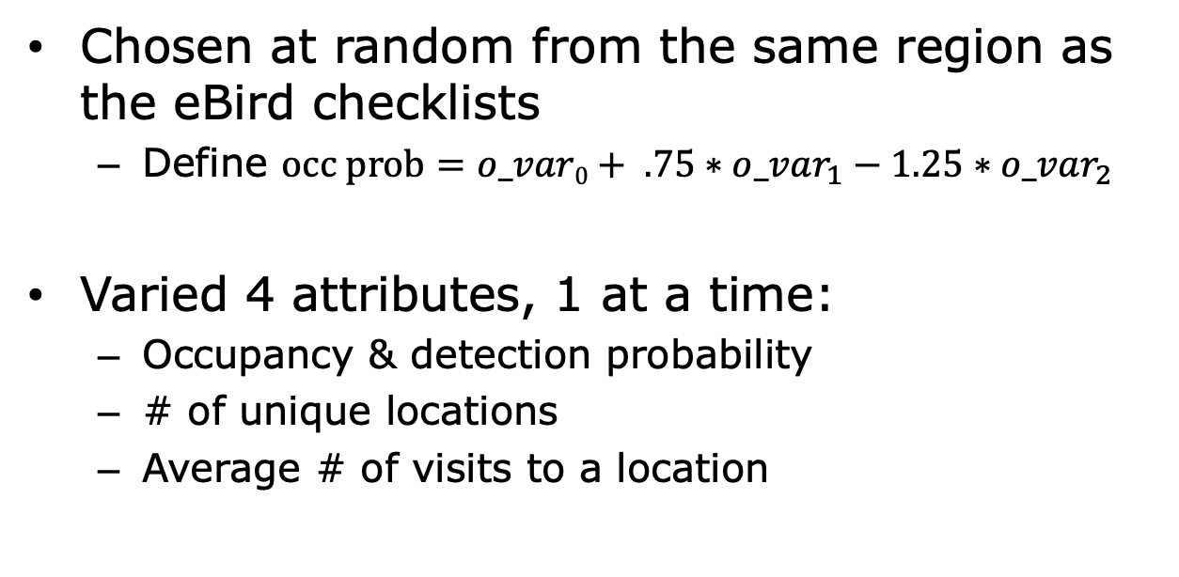
Simulated Experiments
Chosen at random from the same region as the eBird checklists
Define $occ prob=o_var0+ .75∗o_var_{1}−1.25∗o_var_{2}$
Varied 4 attributes, 1 at a time:
Occupancy & detection probability
# of unique locations
Average # of visits to a location
Notes:
Group these checklists into sites with our various clustering algorithms
We divided the variations on each attribute into 3 categories: HIGH AVG and LOW and created 25 datasets in each. For example, we artificially set the occupancy probability above 65% for the HIGH category, and below 35% for the LOW category.

Slide 117
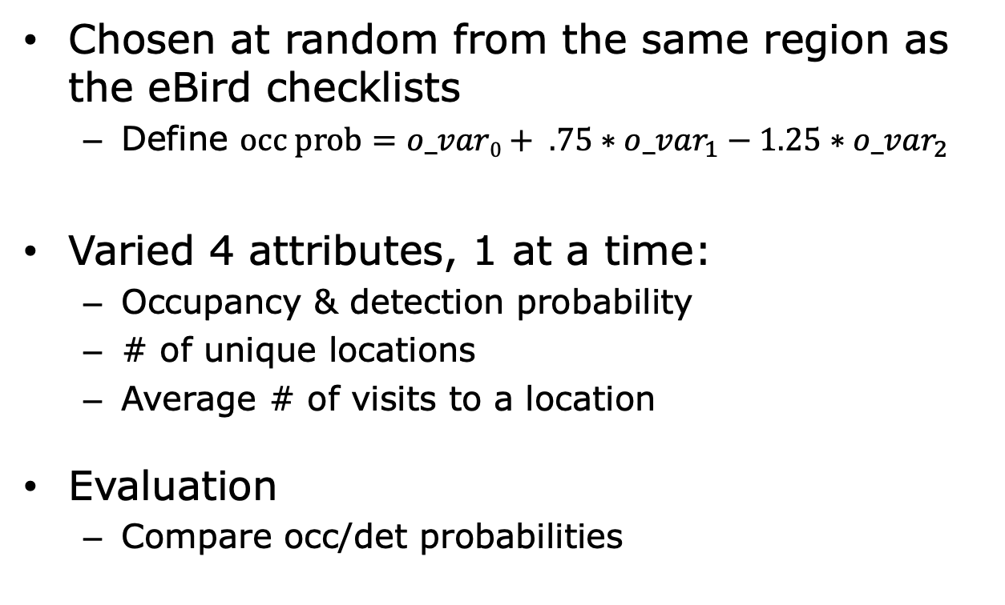
Simulated Experiments
Chosen at random from the same region as the eBird checklists
Define $occ prob=o_var0+ .75∗o_var_{1}−1.25∗o_var_{2}$
Varied 4 attributes, 1 at a time:
Occupancy & detection probability
# of unique locations
Average # of visits to a location
Evaluation
Compare occ/det probabilities
Notes:
Group these checklists into sites with our various clustering algorithms

Slide 118
Experimental Setup
2,146 eBird checklists
Collected between May and July 2017
Remotely sensed environmental variables at each checklist
Manually constructed a ground truth clustering
Notes:
Group these checklists into sites with our various clustering algorithms
True values of our latent variables, which let us test how well our clustering algorithms performed.

Slide 119
Experimental Setup
2,146 eBird checklists
Collected between May and July 2017
Remotely sensed environmental variables at each checklist
Manually constructed a ground truth clustering
Simulated occupancy and detection probabilities for each checklist
Notes:
Group these checklists into sites with our various clustering algorithms
True values of our latent variables, which let us test how well our clustering algorithms performed.

Slide 120
Experimental Setup
$$occ prob=.75∗var_{1}−1.25∗var_{2}+.1∗var_{3}$$
Notes:
Group these checklists into sites with our various clustering algorithms
True values of our latent variables, which let us test how well our clustering algorithms performed.

Slide 121
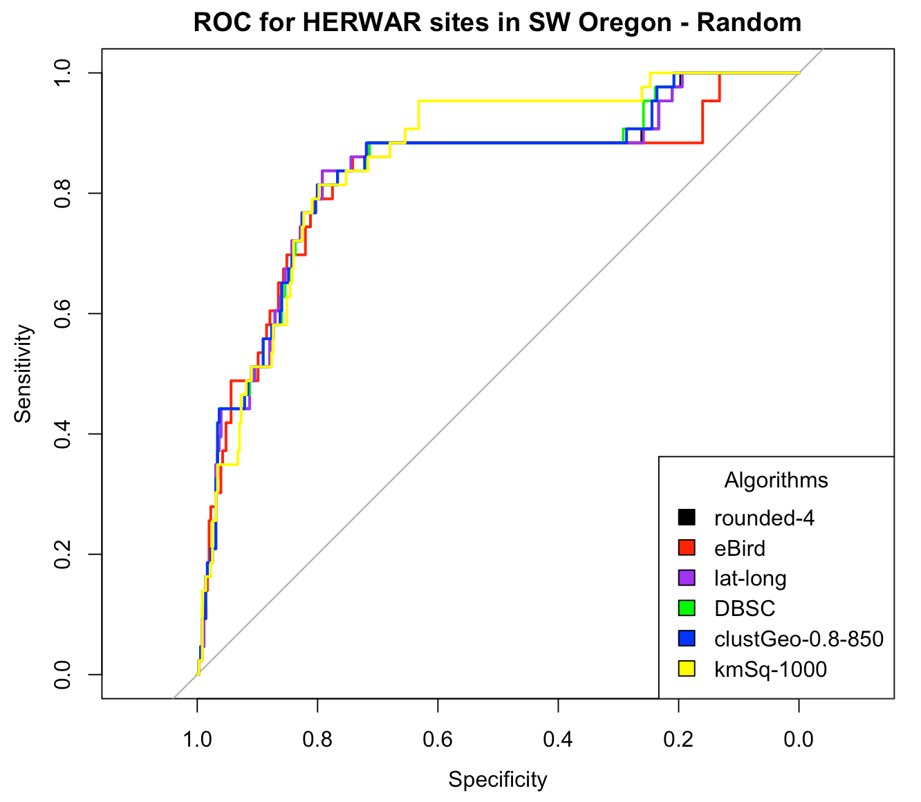
Learnings: Real-Data Experiments

Slide 122
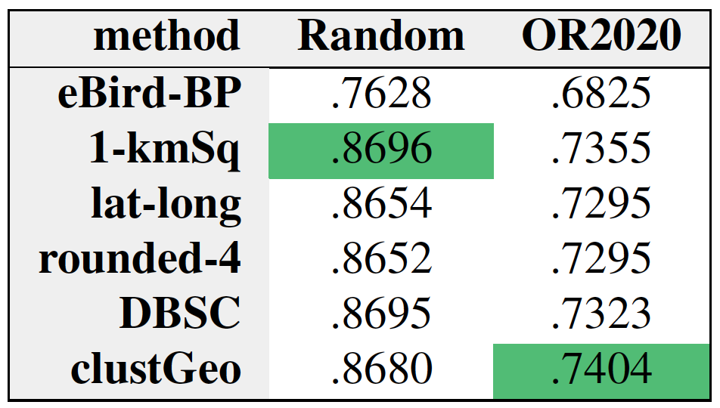
Learnings: Real-Data Experiments
HEWA AUCs

Slide 123
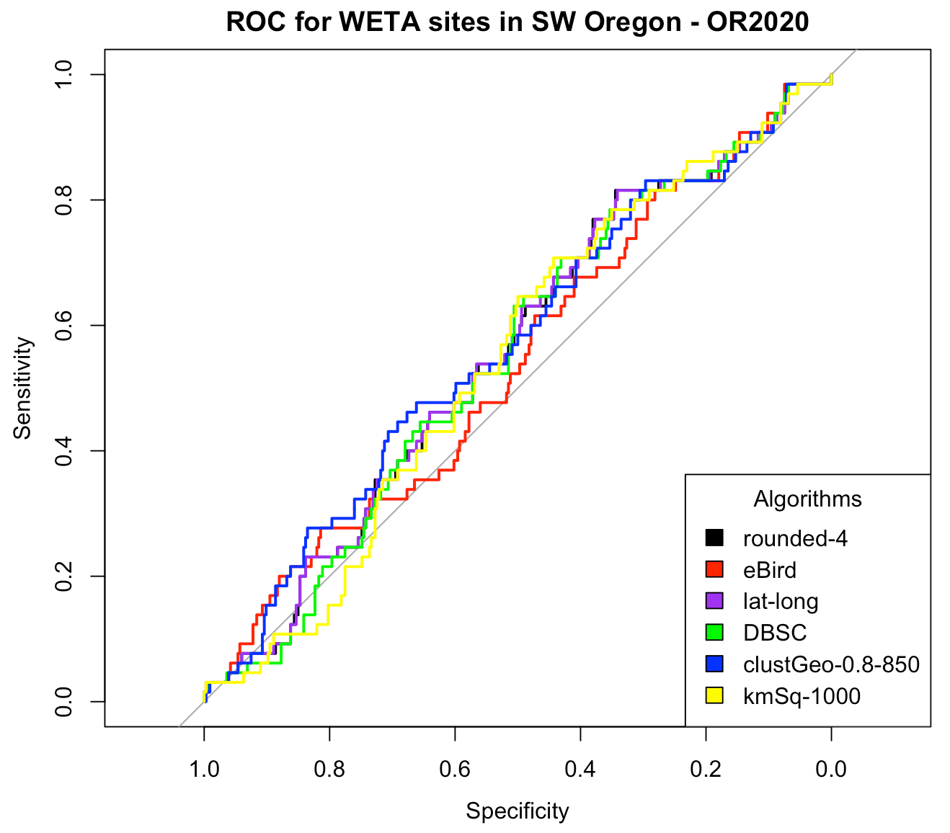
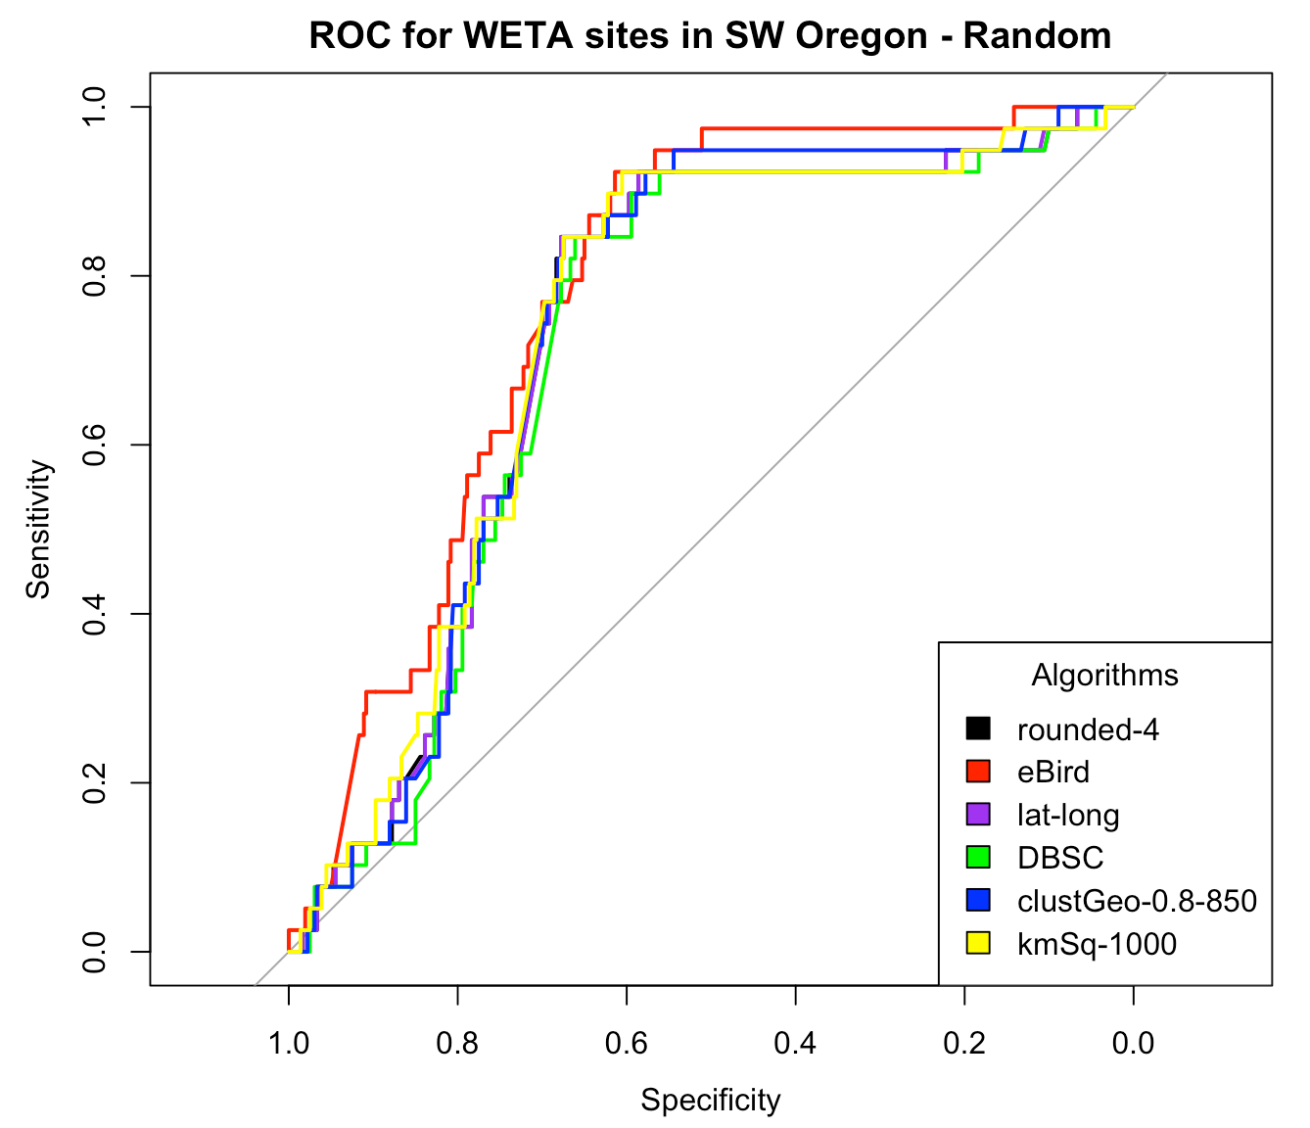
Learnings: Real-Data Experiments

Slide 124
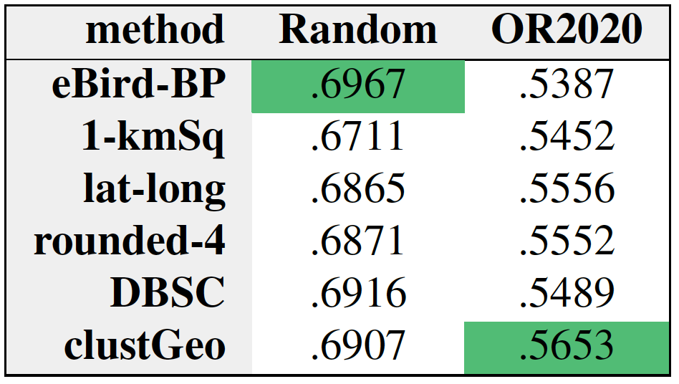
Learnings: Real-Data Experiments
WETA AUC

Slide 125
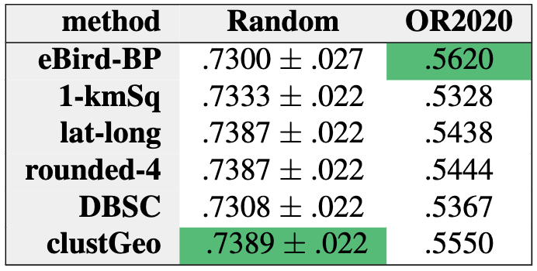
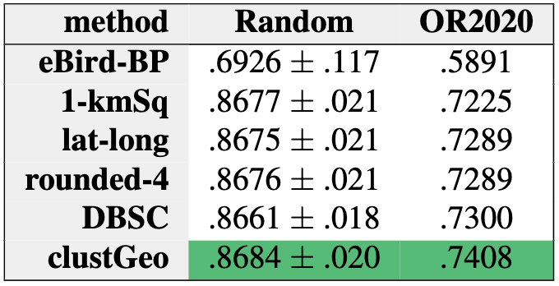
Results: Real-Data Experiments
WETA AUC
HEWA AUC
Both validation sets have 65 1s & 334 0s
Prevalence of…
Validation sets 16.3%
Training sets 11.8%
Both validation sets have 113 1s & 286 0s
Prevalence of…
Validation sets 28.3%
Training sets 8.9%
Notes:
WETA < HEWA; WETA is a generalist species and HEWA is a specialist; WETA is a harder problem because the distinction between suitable and unsuitable habitat is blurred
eBird performs similarly for both species, but far below HEWA.
Random > OR2020 bc of duplicate locations in testing and training.

Slide 126
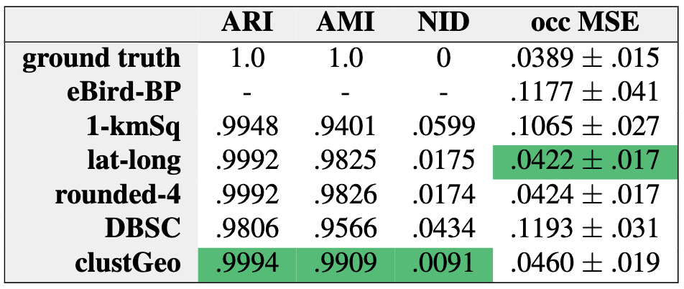
Results : Semi-Simulated Experiments
Notes:
The proposed methods outperform the existing methods!

Slide 127
Results : Semi-Simulated Experiments
Notes:
The proposed methods outperform the existing methods! Suggests
Interesting: similarity does not necessarily correlate with predictive performance; one possible explanation is that clustGeo groups some checklists into sites that don’t maintain closure. So, even though it’s more similar than lat-long & rounded-4 overall, perhaps the places where clustGeo differs are sites that don’t maintain closure, and this negatively affects performance.

Slide 128
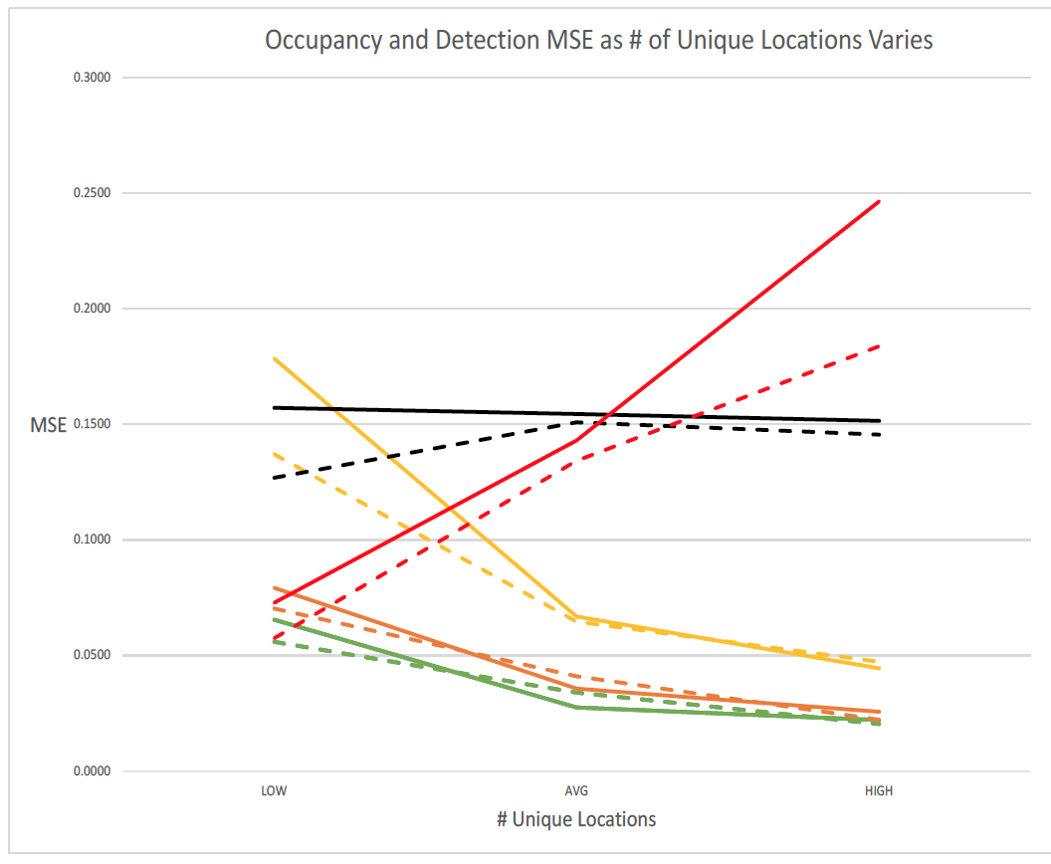
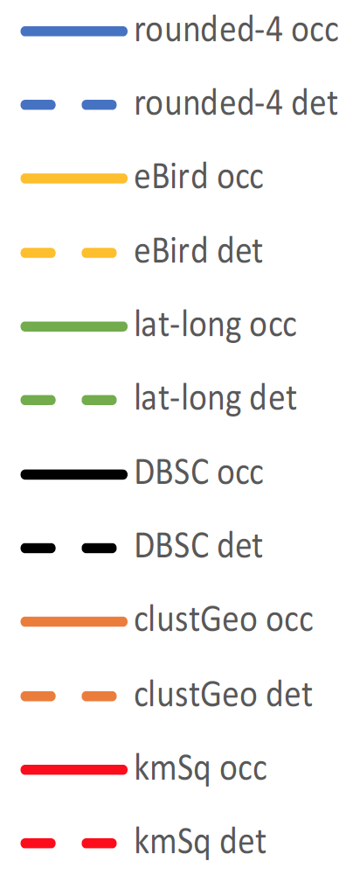
Results : Simulated Experiments
Notes:
Each of the categories we discussed on the x axis
MSE: lower is better
rounded reduces to lat-long
kmSq increases as unique locations increases → bad!

Slide 129
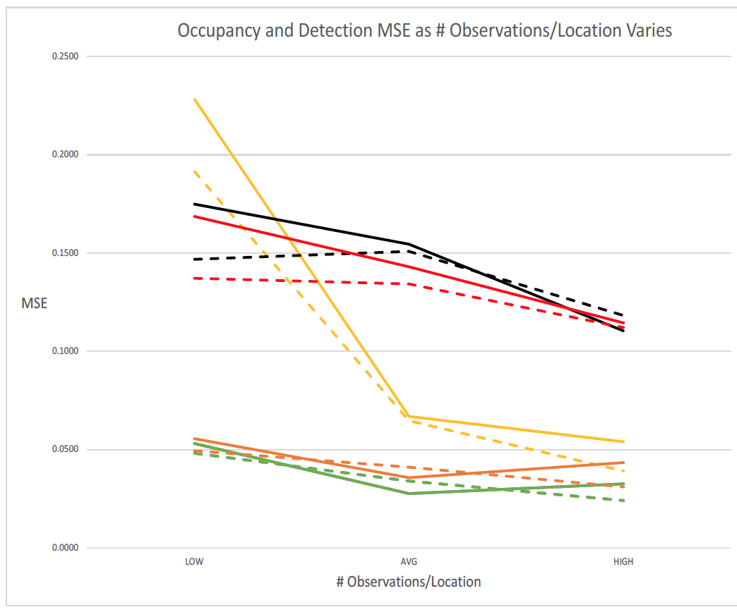
Results : Simulated Experiments
Notes:
eBird’s performance depends on amount of data
clustGeo and rounded/lat-long perform well, even when data is scarce; they don’t vary as much as other algs

Slide 130
Evaluation
Predictive Accuracy
Mean squared error (MSE) of occupancy probability
Notes:
Parameter estimation
Close to ground truth probably means closure is closer to holding
External validation we used the cluster similarity metrics; proxy for closure; no concrete definition

Slide 131
Evaluation
Predictive Accuracy
Mean squared error (MSE) of occupancy probability
External Validation
Similarity to ground truth clustering
Adjusted Rand Index (ARI), Adjusted Mutual Information (AMI), Normalized Information Distance (NID) (Vinh et al. 2010)
Notes:
Parameter estimation
Close to ground truth probably means closure is closer to holding
External validation we used the cluster similarity metrics; proxy for closure; no concrete definition

Slide 132
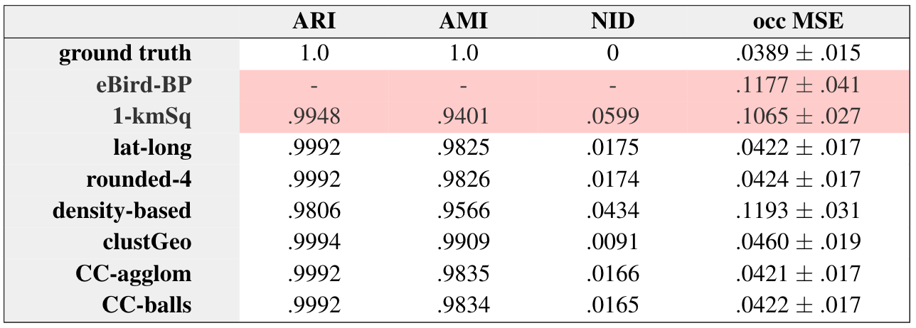
Results
* inputs for both CC algorithms were lat-long, density-based, rounded-4
Notes:
* Similarity metrics for eBird – BP cannot be calculated because the datasets are not the same
* Average occupancy probability error

Slide 133

Contributions
Introduced the Site Clustering Problem
Identified solutions that outperform the existing approaches
Learned ways that algorithms struggle to address this challenge
Great Egret, eBird.org
Notes:
SCP: important for contexts outside of eBird in other community science programs. it may not be grouping checklists into sites, but providing structure to unstructured data is a shared challenge in many community science programs
2. Showed that spatial clustering algorithms are viable solutions to this challenge

Slide 134
Impact
Increases accuracy of (avian) SDMs built from community science data
Informs conservation decisions to mitigate (avian) biodiversity loss
Notes:
And this is important because conservation scientists operate under limited resources. So it’s even more critical for their tools to be accurate

Slide 135
Impact
Increases accuracy of (avian) SDMs built from community science data
Informs conservation decisions to mitigate (avian) biodiversity loss
Introduces a framework to model species at spatial & temporal scales previously unattainable
Notes:
look back thru time to understand how climate change affects species and how they adapt and this can inform future decision making processes

Slide 136
Impact
Increases accuracy of (avian) SDMs built from community science data
Informs conservation decisions to mitigate (avian) biodiversity loss
Introduces a framework to model species at spatial & temporal scales previously unattainable
Builds upon existing literature that validates community science data
Notes:
The role that community science plays in ecological research and beyond is growing bc its introducing sources of big data to domains that have been constrained by a lack of data
And in this process, it’s important that we design methodologies to capitalize on the full potential of this type data.

Slide 137
Conclusions
The existing methods are not well suited to address the Site Clustering Problem
We introduce spatial clustering and naïve algorithms that improve upon the results of the existing approaches
More research!

Slide 138
Future Work

Slide 139
Future Work
Further investigate consensus clustering
Notes:
* Similarity metrics for eBird – BP cannot be calculated because the datasets are not the same
* Average occupancy probability error

Slide 140
Consensus Clustering
Clustering 1
Notes:
Combine the results of other clusterings ; how you decide to combine them is an ongoing research area
Different clustering algorithms have different strengths & weaknesses. If we combine them, can we capitalize on their strengths while mitigating their weaknesses?
I like this because we can include simple, straightforward clusterings to reduce the solution space quickly. (rounded)
Given two checklists, what fraction of clusterings group both checklists into the same site?

Slide 141
Consensus Clustering
Clustering 1
Clustering 2
Notes:
Combine the results of other clusterings ; how you decide to combine them is an ongoing research area
Different clustering algorithms have different strengths & weaknesses. If we combine them, can we capitalize on their strengths while mitigating their weaknesses?
I like this because we can include simple, straightforward clusterings to reduce the solution space quickly. (rounded)
Given two checklists, what fraction of clusterings group both checklists into the same site?

Slide 142
Consensus Clustering
Clustering 1
Clustering 2
Clustering i
Notes:
Combine the results of other clusterings ; how you decide to combine them is an ongoing research area
Different clustering algorithms have different strengths & weaknesses. If we combine them, can we capitalize on their strengths while mitigating their weaknesses?
I like this because we can include simple, straightforward clusterings to reduce the solution space quickly. (rounded)
Given two checklists, what fraction of clusterings group both checklists into the same site?

Slide 143
Consensus Clustering
Clustering 1
Clustering 2
Clustering i
Notes:
Combine the results of other clusterings ; how you decide to combine them is an ongoing research area
Different clustering algorithms have different strengths & weaknesses. If we combine them, can we capitalize on their strengths while mitigating their weaknesses?
I like this because we can include simple, straightforward clusterings to reduce the solution space quickly. (rounded)
Given two checklists, what fraction of clusterings group both checklists into the same site?

Slide 144
Consensus Clustering
Clustering 1
Clustering 2
Consensus Clustering Result
Clustering i
Notes:
Combine the results of other clusterings ; how you decide to combine them is an ongoing research area
Different clustering algorithms have different strengths & weaknesses. If we combine them, can we capitalize on their strengths while mitigating their weaknesses?
I like this because we can include simple, straightforward clusterings to reduce the solution space quickly.
Consensus clustering is a particularly promising method for our domain because `weak' clustering algorithms that we know may not be optimal can still play a role in the final clustering. For example, the lat-long method performs well even though we know it does not build clusters that resemble an expert's definition of a site.

Slide 145
Future Work
Further investigate consensus clustering
Domain-informed spatial clustering algorithm
Home range
Bird call strength (aka, maximum detection distance)
Notes:
* Similarity metrics for eBird – BP cannot be calculated because the datasets are not the same
* Average occupancy probability error

Slide 146
Inputs for a Domain-informed algorithm
Home range
Bird call strength (aka, maximum detection distance)
Notes:
* Both affect the size of ecologically defensible sites

Slide 147
Future Work
Further investigate consensus clustering
Domain-informed spatial clustering algorithm
Home range
Bird call strength (aka, maximum detection distance)
Extend solutions to be spatio-temporal

Slide 148
Future Work
Further investigate consensus clustering
Domain-informed spatial clustering algorithm
Home range
Bird call strength (aka, maximum detection distance)
Extend solutions to be spatio-temporal
Transfer learnings to similar settings
Notes:
* Similarity metrics for eBird – BP cannot be calculated because the datasets are not the same
* Average occupancy probability error

Slide 149
References
Assunção, R. M., Neves, M. C., Câmara, G., and Freitas,
C. D. C. Efficient regionalization techniques for socioeconomic
geographical units using minimum spanning
trees. International Journal of Geographical Information
Science, 20(7):797–811, 2006.
Chavent, M., Kuentz-Simonet, V., Labenne, A., and Saracco,
J. Clustgeo: an r package for hierarchical clustering
with spatial constraints. Computational Statistics, 33(4):
1799–1822, Jan 2018.
Ester, M., Kriegel, H.-P., Sander, J., and Xu, X. A densitybased
algorithm for discovering clusters in large spatial
databases with noise. pp. 226–231, 1996.
Gionis, A., Mannila, H., and Tsaparas, P. Clustering aggregation.
ACM Trans. Knowl. Discov. Data, 1(1):4–es,
March 2007. ISSN 1556-4681.
Guillera-Arroita, G., Lahoz-Monfort, J., MacKenzie, D. I.,
Wintle, B. A., and McCarthy, M. A. Ignoring imperfect
detection in biological surveys is dangerous: a response
to ’fitting and interpreting occupancy models’. PloS one,
9(7):e99571–e99571, 07 2014.
Guo, D. Regionalization with dynamically constrained agglomerative
clustering and partitioning (redcap). International
Journal of Geographical Information Science, 22
(7):801–823, 2008.
Johnston, Alison, et al. "Analytical guidelines to increase the value of community science data: An example using eBird data to estimate species distributions." Diversity and Distributions (2021).
Liu, Q., Deng, M., Shi, Y., and Wang, J. A density-based
spatial clustering algorithm considering both spatial proximity
and attribute similarity. Computers Geosciences,
46:296–309, 2012.
Lloyd, Stuart P. "Least squares quantization in PCM." Information Theory, IEEE Transactions on 28.2 (1982): 129-137.
Ng, R. and Han, J. Clarans: a method for clustering objects
for spatial data mining. IEEE Transactions on Knowledge
and Data Engineering, 14(5):1003–1016, 2002.
Vinh, N. X., Epps, J., and Bailey, J. Information theoretic
measures for clusterings comparison: Variants, properties,
normalization and correction for chance. J. Mach. Learn.
Res., 11:2837–2854, December 2010. ISSN 1532-4435.

Slide 150
Thank You!
To my advisor: Dr. Rebecca Hutchinson
To my committee: Dr. William Douglas Robinson, Dr. Weng-Keen Wong
To collaborators: Dr. Tyler Hallman, Jack Kilbride
To my research group: Dr. Eugene Seo, Laurel Hopkins, Jing Wang, Vishnu Reghunathan, Nahian Ahmed, Andrew Droubay, Chelsea Li, Nate Butler, Demetrius Hernandez, AnaPatricia Medina
To my family, friends, and extended support network

Slide 151
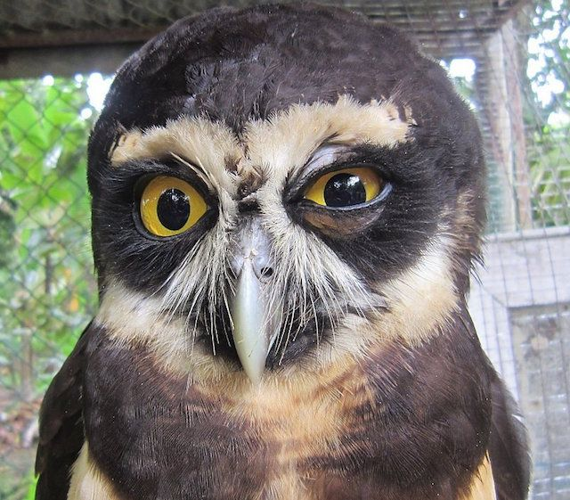
Questions?
https://i.pinimg.com/736x/57/4f/92/574f92c2442ee
bd20a158fd4e2c013d9--human-emotions-owl-eyes.jpg

Slide 152
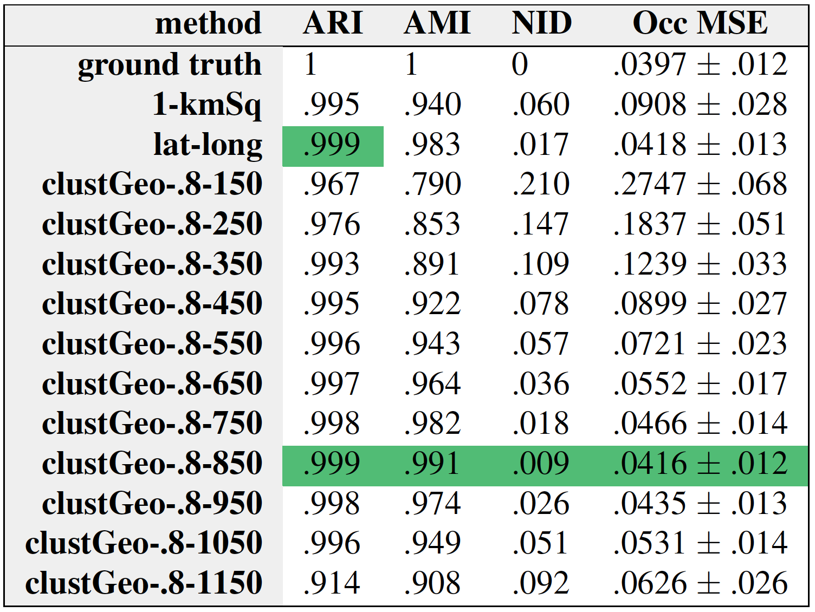
clustGeo: # of sites
Notes:
* Similarity metrics for eBird – BP cannot be calculated because the datasets are not the same
* Average occupancy probability error

Slide 153
